Slide 1
DATA MINING Introductory and Advanced Topics Part I
Dr. Alamgir Kabir
Professor
Department of Statistics, JU

Slide 2
Data Mining Outline
PART I
Introduction
Related Concepts
Data Mining Techniques
PART II
Classification
Clustering
Association Rules
PART III
Web Mining
Spatial Mining
Temporal Mining

Slide 3
Introduction Outline
Goal: Provide an overview of data mining.
Define data mining
Data mining vs. databases
Basic data mining tasks
Data mining development
Data mining issues

Slide 4
Introduction
Data is growing at a remarkable rate
Users expect more sophisticated information
How?
UNCOVER/Discover HIDDEN INFORMATION
DATA MINING

Slide 5
Data Mining Definition
Finding hidden information in a database
Fit data to a model
Similar terms
Exploratory/Empirical data analysis
Data driven discovery/Finding
Deductive/Inferential learning

Slide 6
Data Mining Algorithm
Objective: Fit Data to a Model
Descriptive/Graphic
Predictive/Projecting
Preference – Technique to choose the best model
Search – Technique to search the data
“Query”/request.

Slide 7
Database Processing vs. Data Mining Processing
Query
Well defined
SQL*
Query
Poorly defined
No precise query language
Data
Operational data
Data
Not operational data
Output
Precise
Subset of database
Output
Fuzzy/Unclear
Not a subset of database
* Structured query language (SQL) is a programming language for storing and processing information in a relational database.

Slide 8
Query/Request Examples
Database
Data Mining
Find all credit applicants with last name of Smith.
Identify customers who have purchased more than $10,000 in the last month.
Find all customers who have purchased milk
Find all credit applicants who are poor credit risks. (classification)
Identify customers with similar buying habits. (Clustering)
Find all items which are frequently purchased with milk. (association rules)

Slide 9
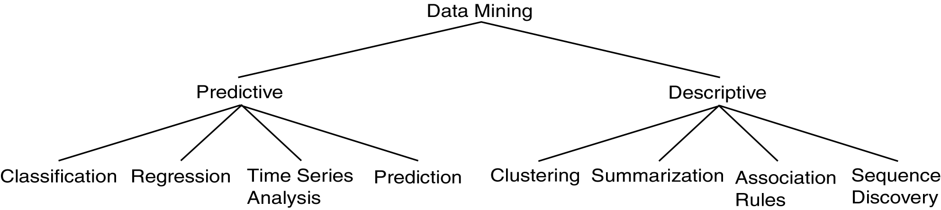
Data Mining Models and Tasks

Slide 10
Basic Data Mining Tasks
Classification maps data into predefined groups or classes
Supervised/Controlled/Managed learning
Pattern/Shape recognition
Prediction/Forecast
Regression is used to map a data item to a real valued prediction variable.
Clustering groups similar data together into clusters.
Unsupervised/Unofficial learning
Segmentation/Breakdown
Partitioning

Slide 11
Basic Data Mining Tasks (cont’d)
Summarization maps data into subsets with associated simple descriptions.
Characterization/Description
Generalization/Broad view
Link Analysis uncovers/finds relationships among data.
Similarity Analysis
Association/Friendship Rules
Sequential/Chronological Analysis determines sequential patterns.

Slide 12
Ex: Time Series Analysis
Example: Stock Market
Predict future values
Determine similar patterns over time
Classify behavior

Slide 13
Data Mining vs. KDD
Knowledge Discovery in Databases (KDD): process of finding useful information and patterns/shapes in data.
Data Mining: Use of algorithms to extract the information and patterns derived by the KDD process.

Slide 14
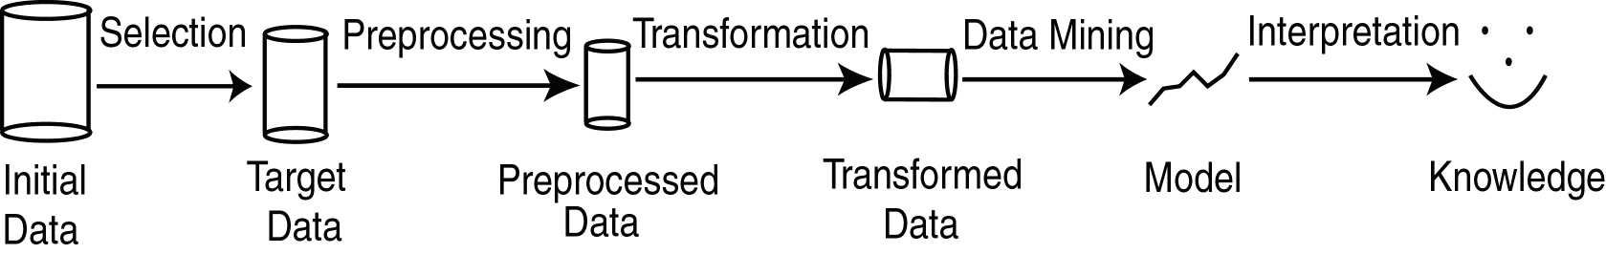
KDD Process
Modified from [FPSS96C]
Selection: Obtain data from various sources.
Preprocessing: Cleanse data.
Transformation: Convert to common format. Transform to new format.
Data Mining: Obtain desired results.
Interpretation/Evaluation: Present results to the user in meaningful manner.

Slide 15
KDD Process Ex: Web Log
Selection:
Select log data (dates and locations) to use
Preprocessing:
Remove identifying URLs
Remove error logs
Transformation:
Sectionize (sort and group)
Data Mining:
Identify and count patterns
Construct data structure
Interpretation/Evaluation:
Identify and display frequently accessed sequences.
Potential User Applications:
Reserve prediction
Personalization

Slide 16
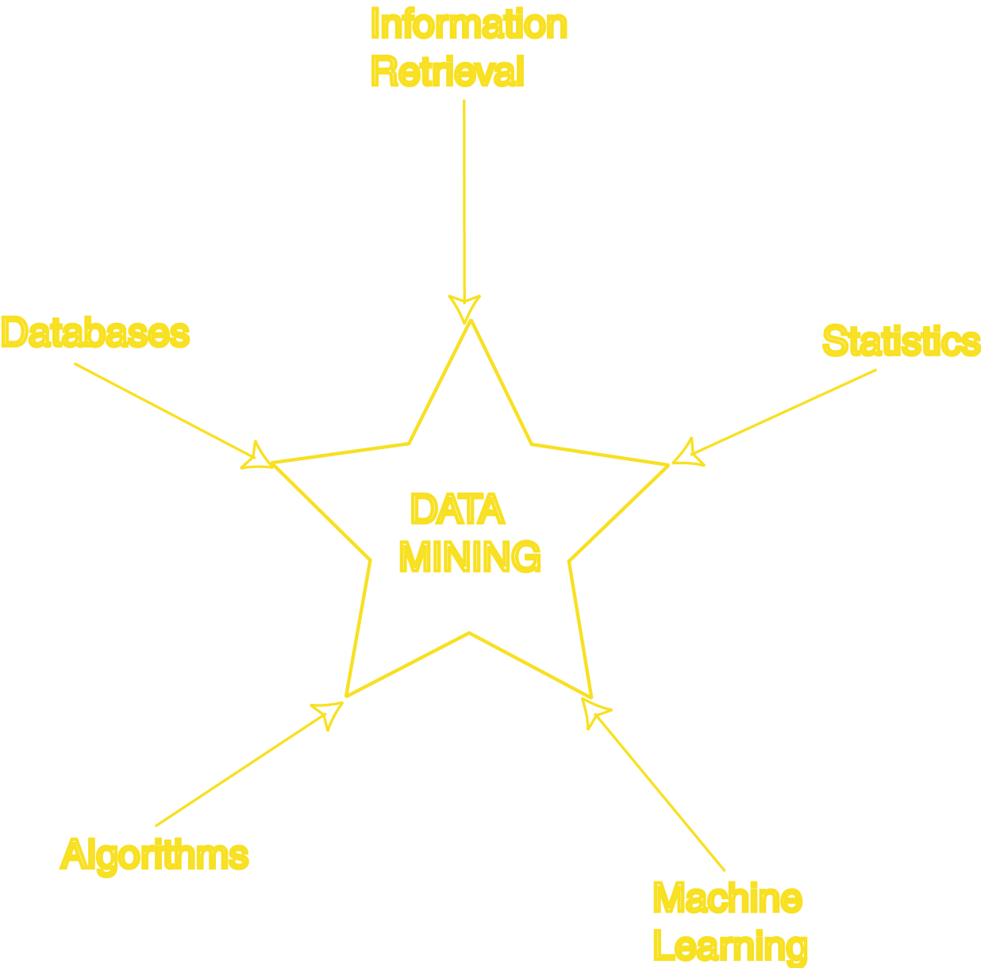
Data Mining Development
Similarity Measures
Hierarchical Clustering
IR Systems
Imprecise Queries
Textual Data
Web Search Engines
Relational Data Model
SQL
Association Rule Algorithms
Data Warehousing
Scalability Techniques
Bayes Theorem
Regression Analysis
EM Algorithm
K-Means Clustering
Time Series Analysis
Algorithm Design Techniques
Algorithm Analysis
Data Structures
Neural Networks
Decision Tree Algorithms
Expectation Maximization (EM)

Slide 17
KDD Issues
Human Interaction/contact
Overfitting
Outliers
Interpretation
Visualization
Large Datasets
High Dimensionality

Slide 18
KDD Issues (cont’d)
Multimedia Data
Missing Data
Irrelevant Data
Noisy/blaring Data
Changing/fluctuating Data
Integration/incorporation
Application

Slide 19
Social Implications of DM
Privacy/confidentiality
Profiling/summarizing
Unauthorized/illegal use

Slide 20
Data Mining Metrics
Usefulness
Return on Investment (ROI)
Accuracy
Space/Time

Slide 21
Database Perspective on Data Mining
Scalability
Real World Data
Updates
Ease/comfort of Use

Slide 22
Visualization Techniques
Graphical
Geometric
Icon-based
Pixel-based
Hierarchical
Hybrid

Slide 23
Related Concepts Outline
Goal: Examine some areas which are related to data mining.
Database/OLTP Systems
Data Warehousing
OLAP/DSS
Statistics
Machine Learning
Pattern Matching
Online Transaction Processing (OLTP)
Online analytical processing (OLAP)
Decision Support System (DSS)

Slide 24
Database & OLTP Systems
Outline
(ID, Name, Address, Salary, Job No.)
Data Model
ER (Entity Relationship)
Relational/interpersonal
Transaction/business deal
Query:
SELECT Name
FROM T
WHERE Salary > 100000
DM: Only imprecise queries

Slide 25
Data Warehousing
“Subject-oriented, integrated, time-variant, nonvolatile” William Inmon
Operational Data: Data used in day to day needs of company.
Informational Data: Supports other functions such as planning and forecasting.
Data mining tools often access data warehouses rather than operational data.
DM: May access data in warehouse.

Slide 26
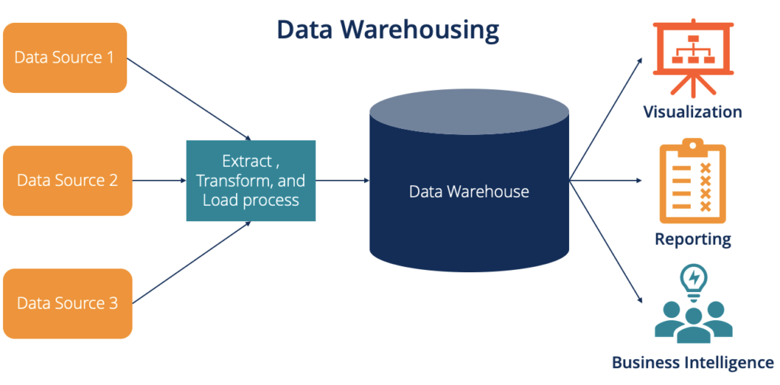
A data warehouse is a type of data management system that is designed to enable and support business intelligence (BI) activities, especially analytics.

Slide 27
Operational vs. Informational
Operational Data
Data Warehouse
Application
OLTP
OLAP
Use
Precise Queries
Ad Hoc
Temporal
Snapshot
Historical
Modification
Dynamic
Static
Orientation
Application
Business
Data
Operational Values
Integrated
Size
Gigabits
Terabits
Level
Detailed
Summarized
Access
Often
Less Often
Response
Few Seconds
Minutes
Data Scheme
Relational
Star/Snowflake

Slide 28
OLAP
Online Analytic Processing (OLAP): provides more complex queries than OLTP.
OnLine Transaction Processing (OLTP): traditional database/transaction processing.
Dimensional data; cube view
Visualization of operations:
Slice: examine sub-cube.
Dice: rotate cube to look at another dimension.
Roll Up/Drill Down
DM: May use OLAP queries.

Slide 29
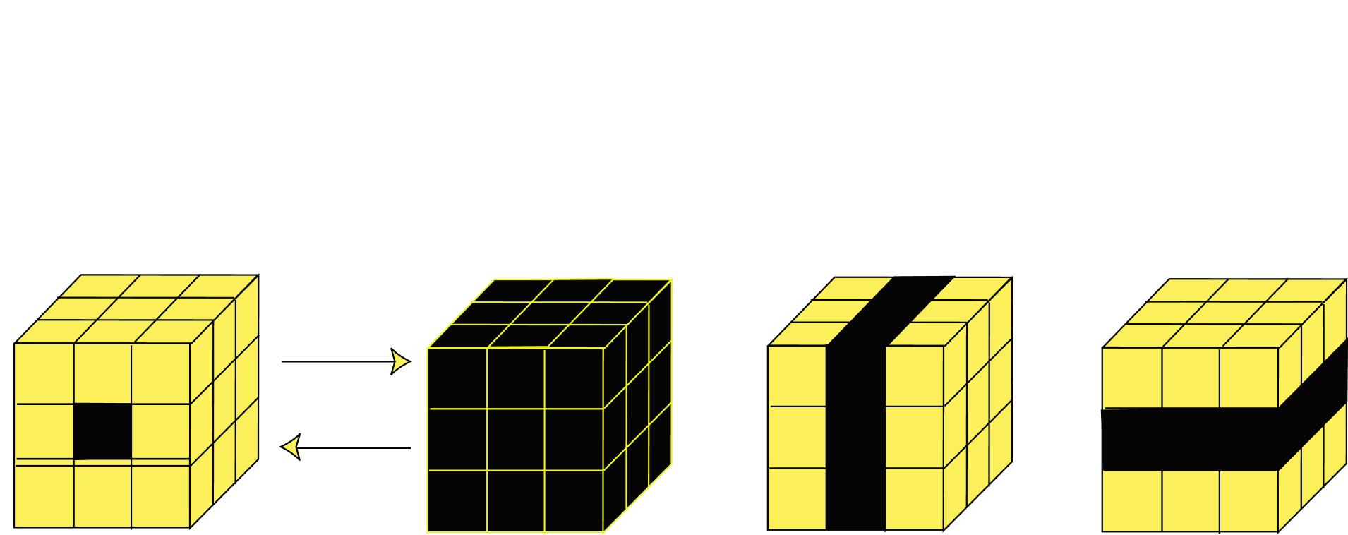
OLAP Operations
Roll Up
Drill Down
Single Cell
Multiple Cells
Slice
Dice

Slide 30
Statistics
Simple descriptive models
Statistical inference: generalizing a model created from a sample of the data to the entire dataset.
Exploratory Data Analysis:
Data can actually drive the creation of the model
Opposite of traditional statistical view.
Data mining targeted to business user
DM: Many data mining methods come from statistical techniques.

Slide 31
Machine Learning
Machine Learning: area of AI that examines how to write programs that can learn.
Often used in classification and prediction
Supervised Learning: learns by example.
Unsupervised Learning: learns without knowledge of correct answers.
Machine learning often deals with small static datasets.
DM: Uses many machine learning techniques.

Slide 32
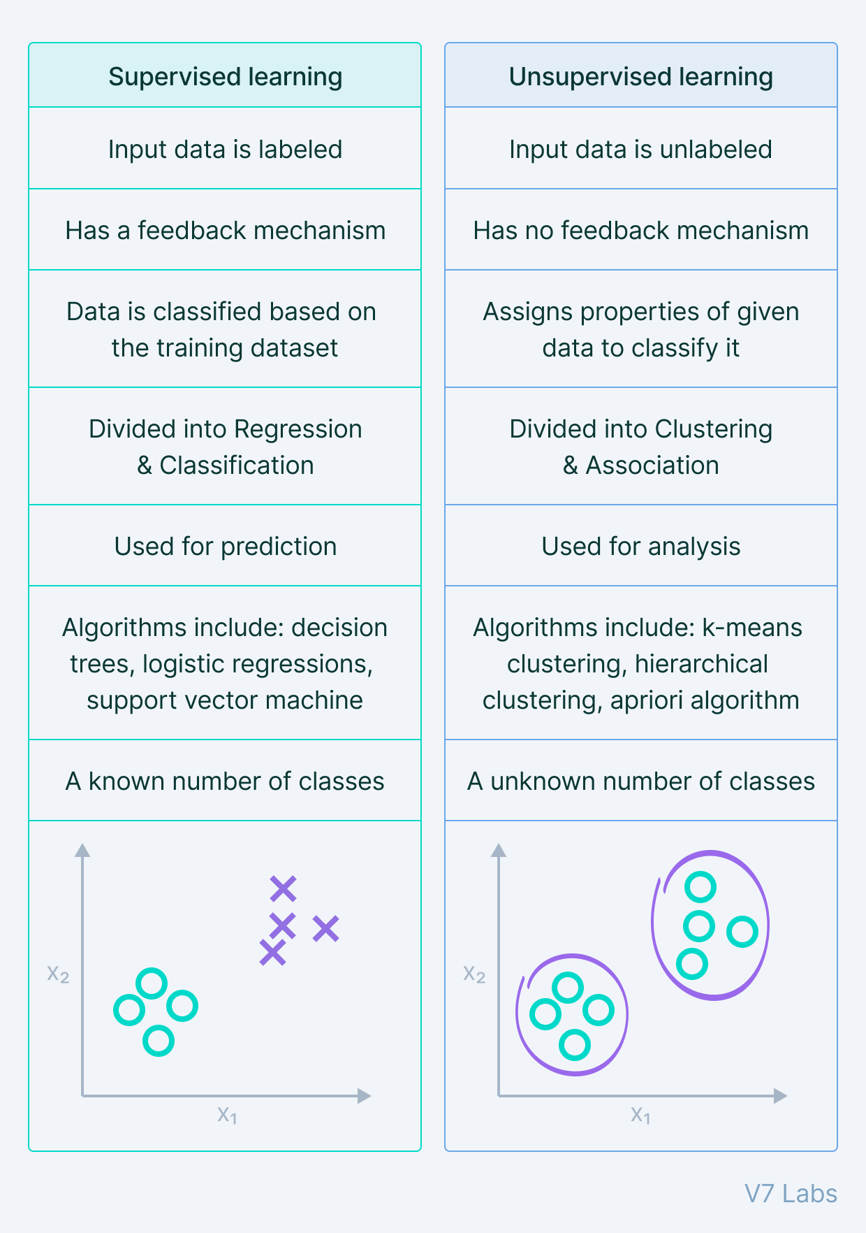

Slide 33
Pattern Matching (Recognition)
Pattern Matching: finds occurrences of a predefined pattern in the data.
Applications include speech recognition, information retrieval, time series analysis.
DM: Type of classification.

Slide 34
DM vs. Related Topics

Slide 35
Data Mining Techniques Outline
Goal: Provide an overview of basic data mining techniques
Statistical
Point Estimation
Models Based on Summarization
Bayes Theorem
Hypothesis Testing
Regression and Correlation
Similarity Measures
Decision Trees
Neural Networks
Activation Functions
Genetic Algorithms

Slide 36
Point Estimation
Point Estimate: estimate a population parameter.
May be made by calculating the parameter for a sample.
May be used to predict value for missing data.
Ex:
R contains 100 employees
99 have salary information
Mean salary of these is $50,000
Use $50,000 as value of remaining employee’s salary.
Is this a good idea?

Slide 37
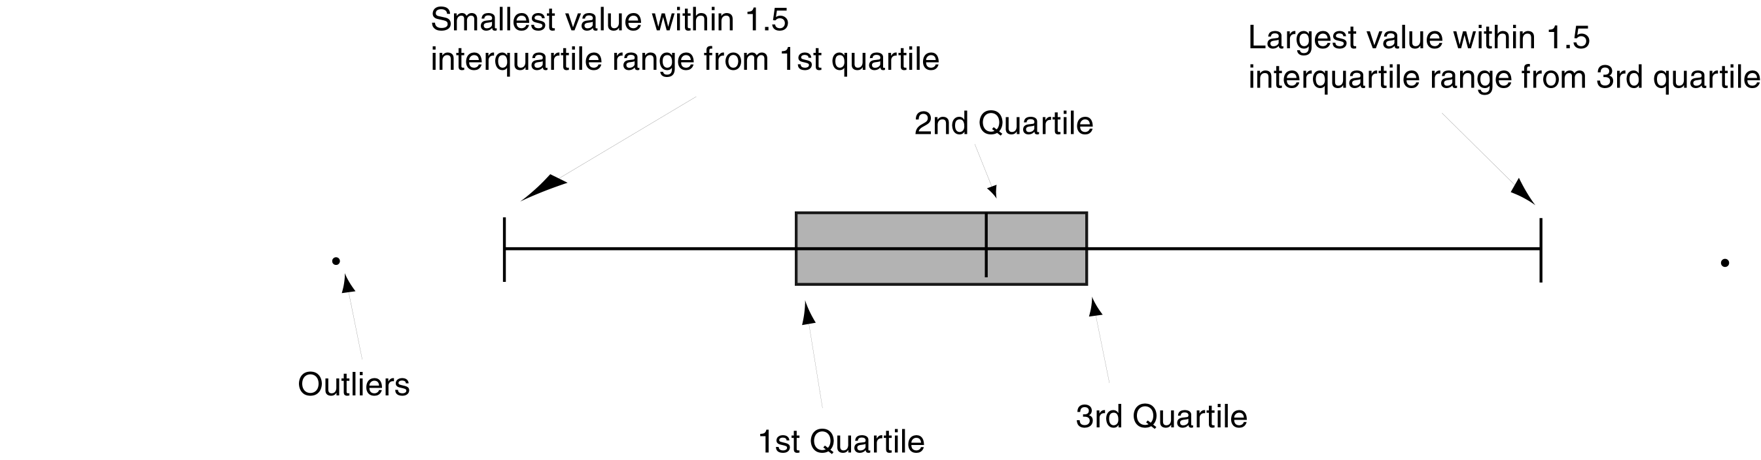
Models Based on Summarization
Visualization: Frequency distribution, mean, variance, median, mode, etc.
Box Plot:

Slide 38
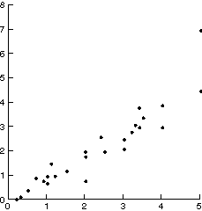
Scatter Diagram

Slide 39
Hypothesis Testing
Find model to explain behavior by creating and then testing a hypothesis about the data.
Exact opposite of usual DM approach.
H₀ – Null hypothesis; Hypothesis to be tested.
H₁ – Alternative hypothesis

Slide 40
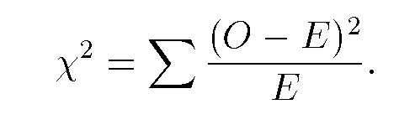
Chi Squared Statistic
O – observed value
E – Expected value based on hypothesis.
Ex:
O={50,93,67,78,87}
E=75
χ²=15.55 and therefore significant

Slide 41
Regression
Predict future values based on past values
Linear Regression assumes linear relationship exists.
y = c₀ + c₁ x₁ + … + c_{n} x_{n}
Find values to best fit the data

Slide 42
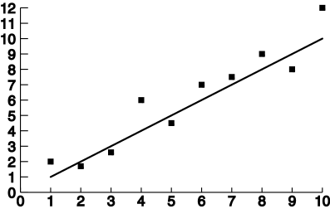
Linear Regression

Slide 43
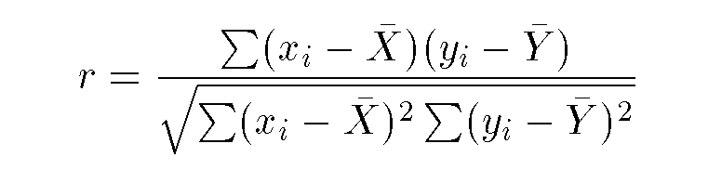
Correlation
Examine the degree to which the values for two variables behave similarly.
Correlation coefficient r:
1 = perfect correlation
-1 = perfect but opposite correlation
0 = no correlation

Slide 44
Decision Trees
Decision Tree (DT):
Tree where the root and each internal node is labeled with a question.
The curves represent each possible answer to the associated question.
Each leaf node represents a prediction of a solution to the problem.
Popular technique for classification; Leaf node indicates class to which the corresponding tuple belongs.

Slide 45
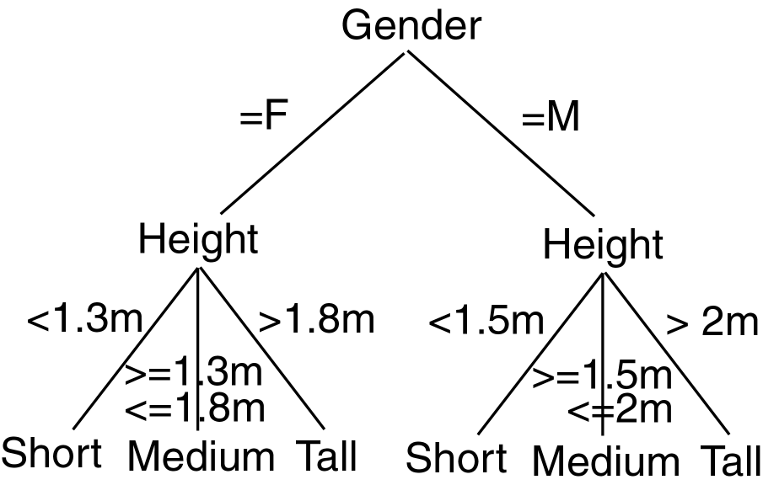
Decision Tree Example

Slide 46
Decision Trees
A Decision Tree Model is a computational model consisting of three parts:
Decision Tree
Algorithm to create the tree
Algorithm that applies the tree to data
Creation of the tree is the most difficult part.
Processing is basically a search similar to that in a binary search tree (although DT may not be binary).

Slide 47
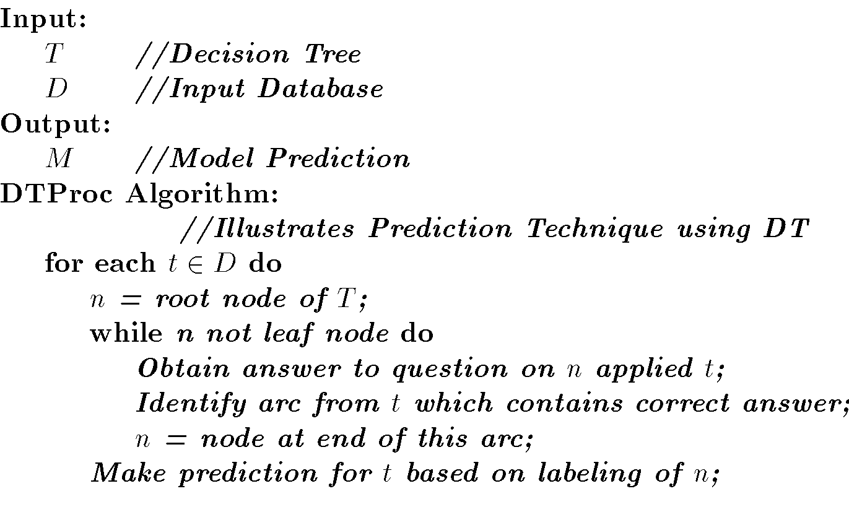
Decision Tree Algorithm

Slide 48
DT Advantages/Disadvantages
Advantages:
Easy to understand.
Easy to generate rules
Disadvantages:
May suffer from overfitting.
Classifies by rectangular partitioning.
Does not easily handle nonnumeric data.
Can be quite large – pruning is necessary.

Slide 49
Neural Networks
Based on observed functioning of human brain.
(Artificial Neural Networks (ANN)
Our view of neural networks is very simplistic.
We view a neural network (NN) from a graphical viewpoint.
Alternatively, a NN may be viewed from the perspective of matrices.
Used in pattern recognition, speech recognition, computer vision, and classification.

Slide 50
NN Learning
Propagate input values through graph.
Compare output to desired output.
Adjust weights in graph accordingly.

Slide 51
Neural Networks
A Neural Network Model is a computational model consisting of three parts:
Neural Network graph
Learning algorithm that indicates how learning takes place.
Recall techniques that determine how information is obtained from the network.
We will look at broadcast as the recall technique.

Slide 52
NN Advantages
Learning
Can continue learning even after training set has been applied.
Easy parallelization
Solves many problems

Slide 53
NN Disadvantages
Difficult to understand
May suffer from overfitting
Structure of graph must be determined a priori.
Input values must be numeric.
Verification difficult.

Slide 54
Genetic Algorithms
Optimization search type algorithms.
Creates an initial feasible solution and iteratively creates new “better” solutions.
Based on human evolution and survival of the fittest.
Must represent a solution as an individual.
Individual: string I=I₁,I₂,…,I_{n} where I_{j} is in given alphabet A.
Each character I_{j} is called a gene.
Population: set of individuals.

Slide 55
Genetic Algorithms
A Genetic Algorithm (GA) is a computational model consisting of five parts:
A starting set of individuals, P.
Crossover: technique to combine two parents to create offspring.
Mutation: randomly change an individual.
Fitness: determine the best individuals.
Algorithm which applies the crossover and mutation techniques to P iteratively using the fitness function to determine the best individuals in P to keep.

Slide 56
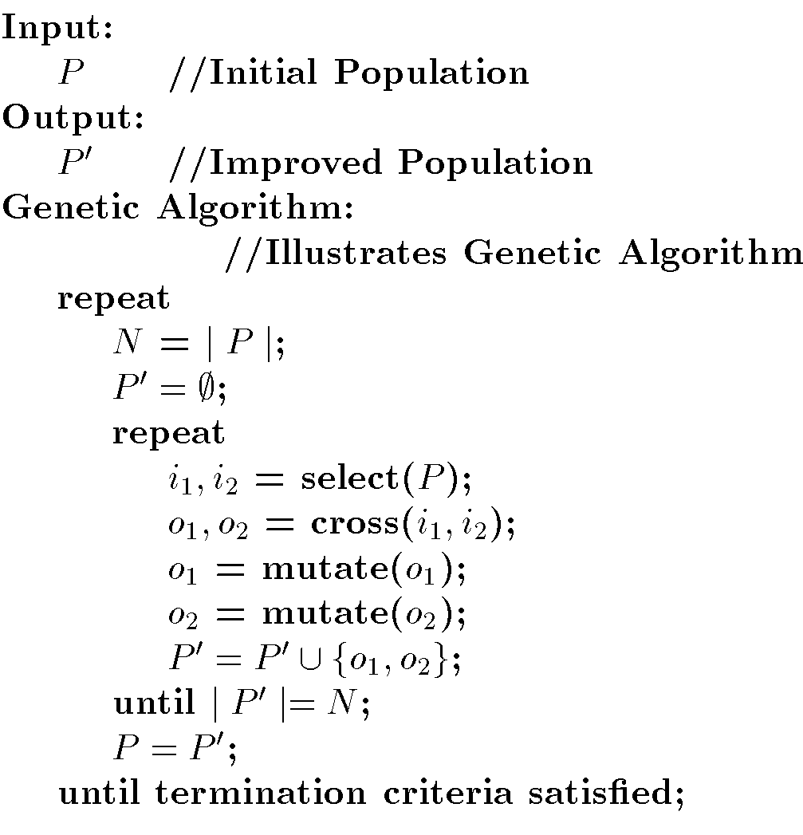
Genetic Algorithm

Slide 57
GA Advantages/Disadvantages
Advantages
Easily parallelized
Disadvantages
Difficult to understand and explain to end users.
Abstraction of the problem and method to represent individuals is quite difficult.
Determining fitness function is difficult.
Determining how to perform crossover and mutation is difficult.

Slide 58
DATA MINING Introductory and Advanced Topics Part II

Slide 59
Data Mining Outline
PART I
Introduction
Related Concepts
Data Mining Techniques
PART II
Classification
Clustering
Association Rules
PART III
Web Mining
Spatial Mining
Temporal Mining

Slide 60
Classification Outline
Goal: Provide an overview of the classification problem and introduce some of the basic algorithms
Classification Problem Overview
Classification Techniques
Regression
Distance
Decision Trees
Rules
Neural Networks

Slide 61
Classification Problem
Given a database D={t₁,t₂,…,t_{n}} and a set of classes C={C₁,…,C_{m}}, the Classification Problem is to define a mapping f:DgC where each t_{i} is assigned to one class.
Actually divides D into equivalence classes.
Prediction is similar, but may be viewed as having infinite number of classes.

Slide 62
Classification Examples
Teachers classify students’ grades as A, B, C, D, or F.
Identify mushrooms as poisonous or edible.
Predict when a river will flood.
Identify individuals with credit risks.
Speech recognition
Pattern recognition

Slide 63
Classification Ex: Grading
x
If x >= 90 then grade =A.
If 80<=x<90 then grade =B.
If 70<=x<80 then grade =C.
If 60<=x<70 then grade =D.
If x<50 then grade =F.
<90
>=90
x
A
<80
>=80
x
B
<70
>=70
x
C
<50
>=60
F
D

Slide 64
Classification Techniques
Approach:
Create specific model by evaluating training data (or using domain experts’ knowledge).
Apply model developed to new data.
Classes must be predefined
Most common techniques use DTs, NNs, or are based on distances or statistical methods.

Slide 65
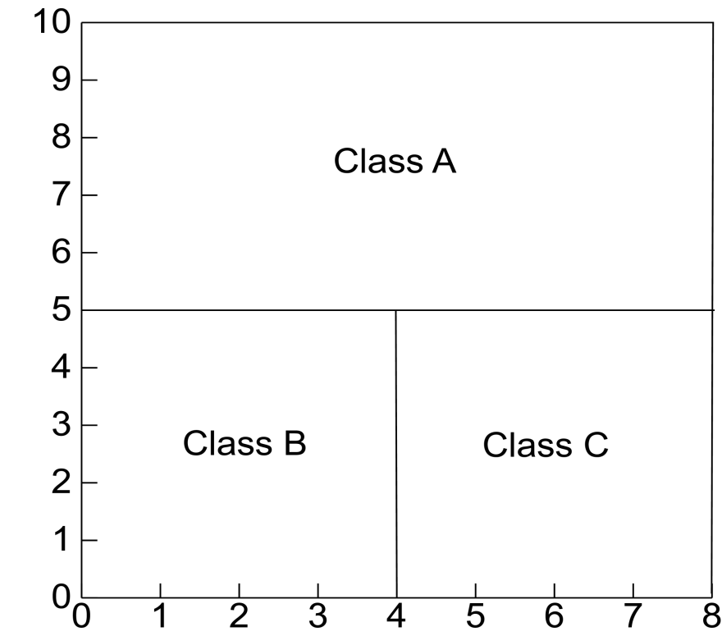
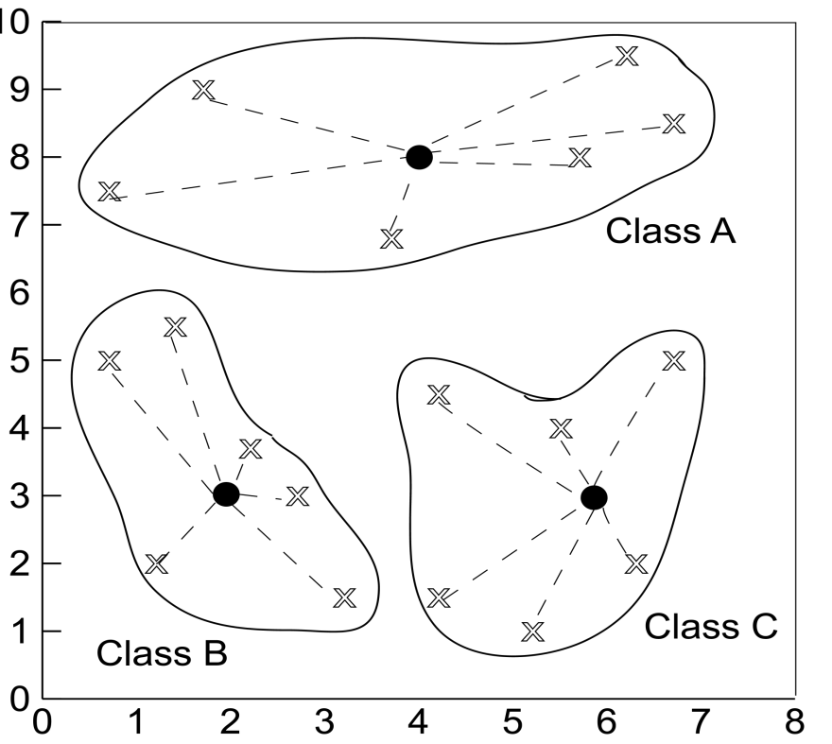
Defining Classes
Distance Based
Partitioning Based

Slide 66
Issues in Classification
Missing Data
Ignore
Replace with assumed value
Measuring Performance
Classification accuracy on test data
Confusion matrix
OC Curve

Slide 67
Height Example Data

Slide 68
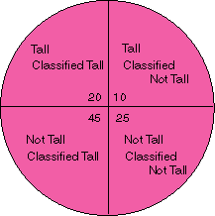
Classification Performance
True Positive
False Negative
False Positive
True Negative

Slide 69
Confusion Matrix Example
Using height data example with Output1 correct and Output2 actual assignment

Slide 70
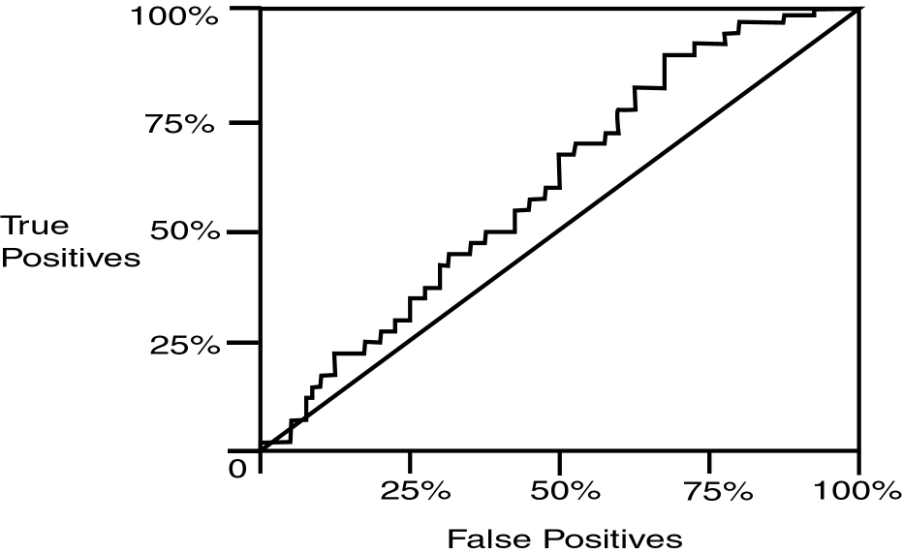
Operating Characteristic Curve

Slide 71
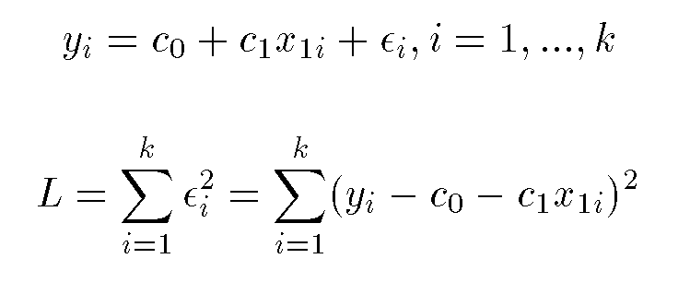
Regression
Assume data fits a predefined function
Determine best values for regression coefficients c₀,c₁,…,c_{n}.
Assume an error: y = c₀+c₁x₁+…+c_{n}x_{n}+ε
Estimate error using mean squared error for training set:

Slide 72
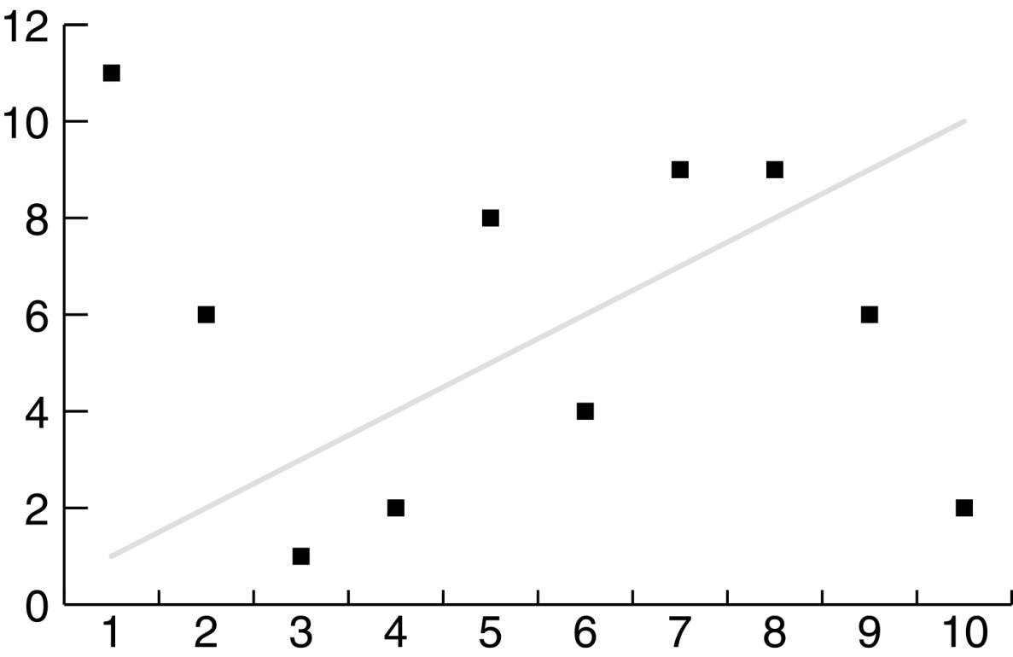
Linear Regression Poor Fit

Slide 73
Classification Using Regression
Division: Use regression function to divide area into regions.
Prediction: Use regression function to predict a class membership function. Input includes desired class.

Slide 74
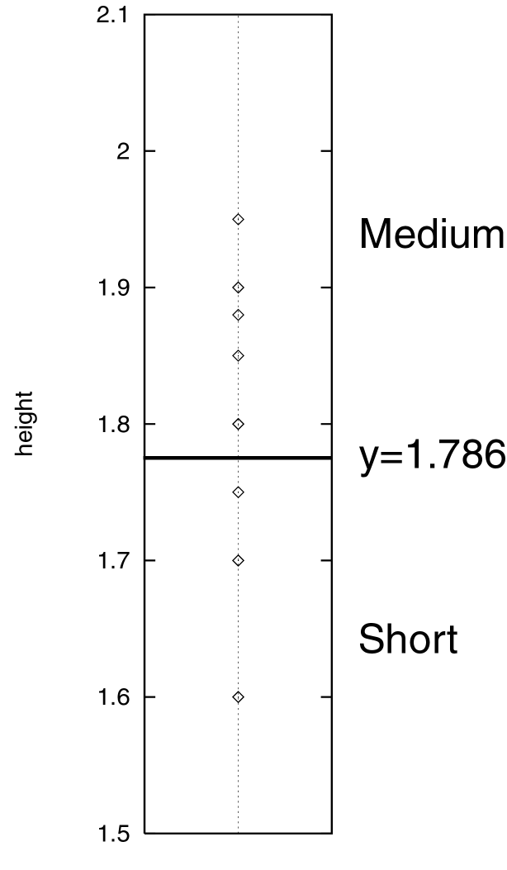
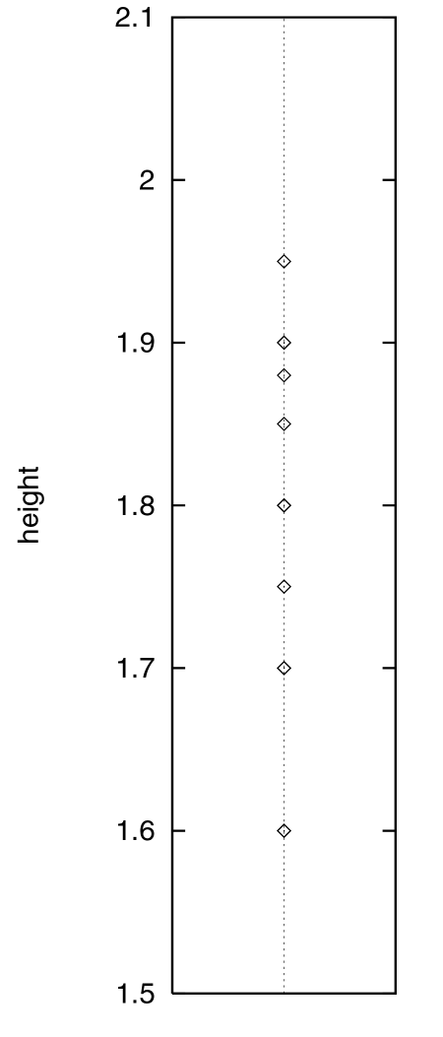
Division

Slide 75
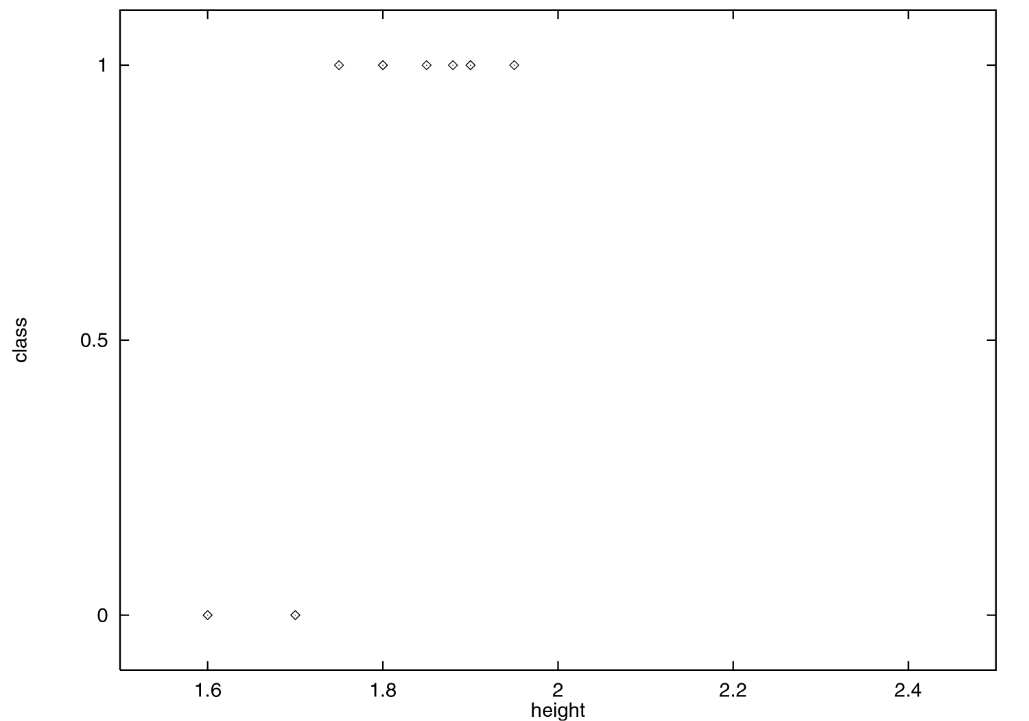
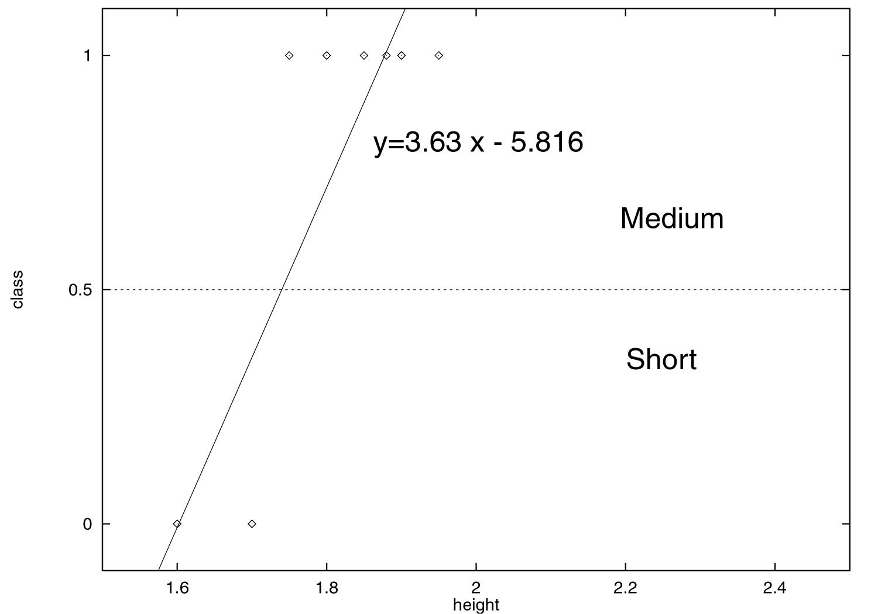
Prediction

Slide 76
Classification Using Distance
Place items in class to which they are “closest”.
Must determine distance between an item and a class.
Classes represented by
Centroid: Central value.
Medoid: Representative point.
Individual points
Algorithm: KNN

Slide 77
K Nearest Neighbor (KNN):
Training set includes classes.
Examine K items near item to be classified.
New item placed in class with the most number of close items.
O(q) for each tuple to be classified. (Here q is the size of the training set.)

Slide 78
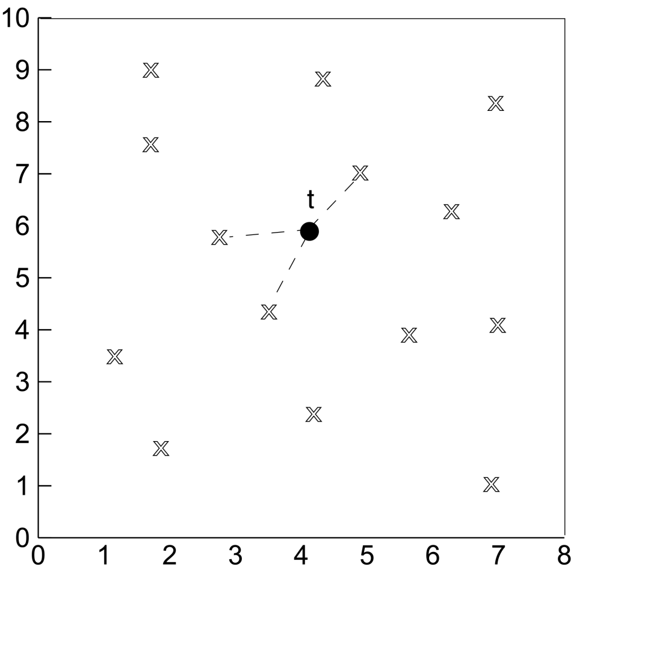
KNN

Slide 79
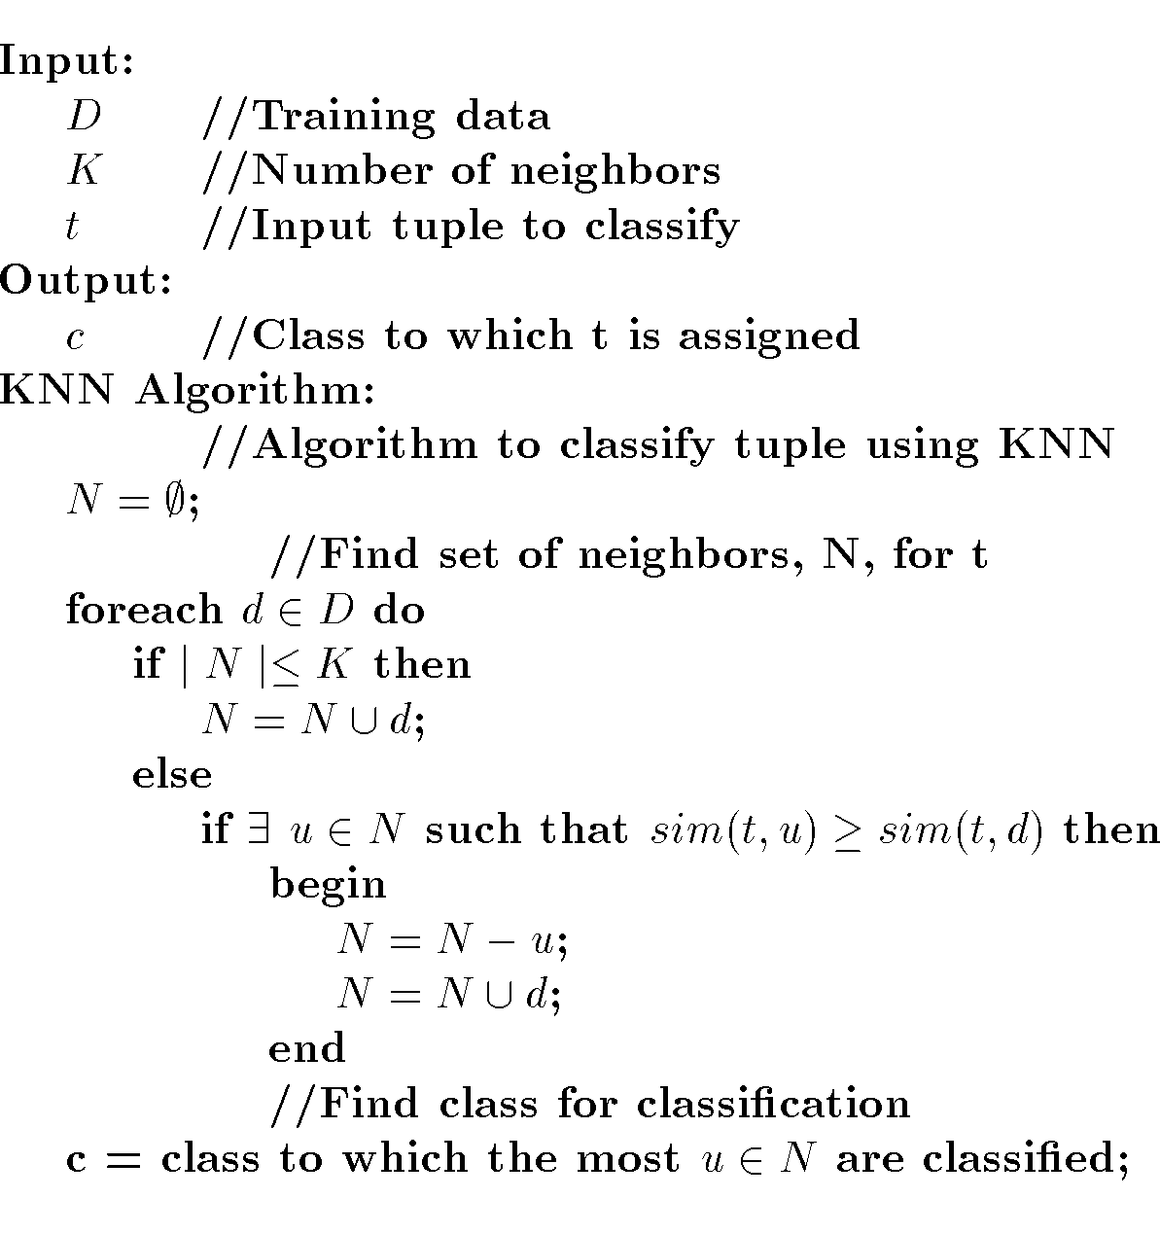
KNN Algorithm

Slide 80
Classification Using Decision Trees
Partitioning based: Divide search space into rectangular regions.
Tuple placed into class based on the region within which it falls.
DT approaches differ in how the tree is built: DT Induction
Internal nodes associated with attribute and arcs with values for that attribute.
Algorithms: ID3, C4.5, CART

Slide 81
Decision Tree
Given:
D = {t₁, …, t_{n}} where t_{i}=<t_{i1}, …, t_{ih}>
Database schema contains {A₁, A₂, …, A_{h}}
Classes C={C₁, …., C_{m}}
Decision or Classification Tree is a tree associated with D such that
Each internal node is labeled with attribute, A_{i}
Each arc is labeled with predicate which can be applied to attribute at parent
Each leaf node is labeled with a class, C_{j}

Slide 82
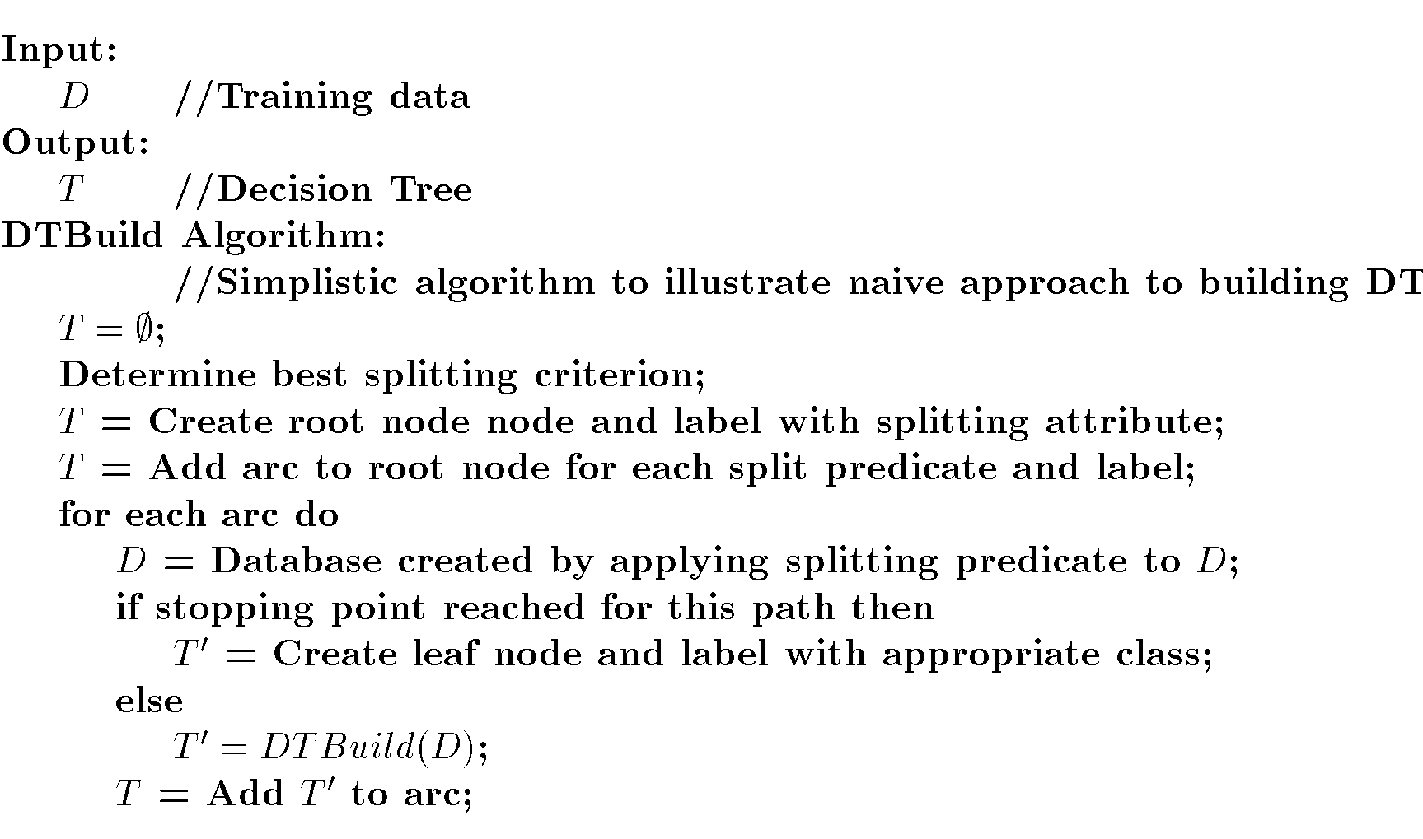
DT Induction

Slide 83
DT Splits Area
M
Gender
F
Height

Slide 84
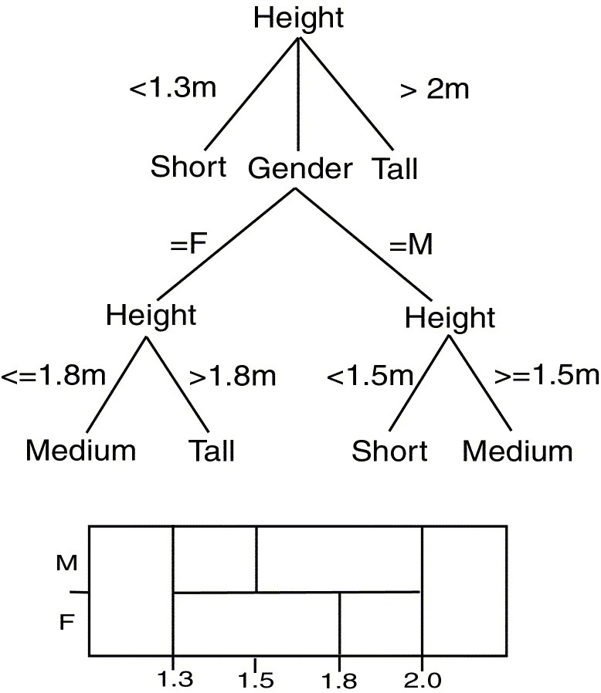
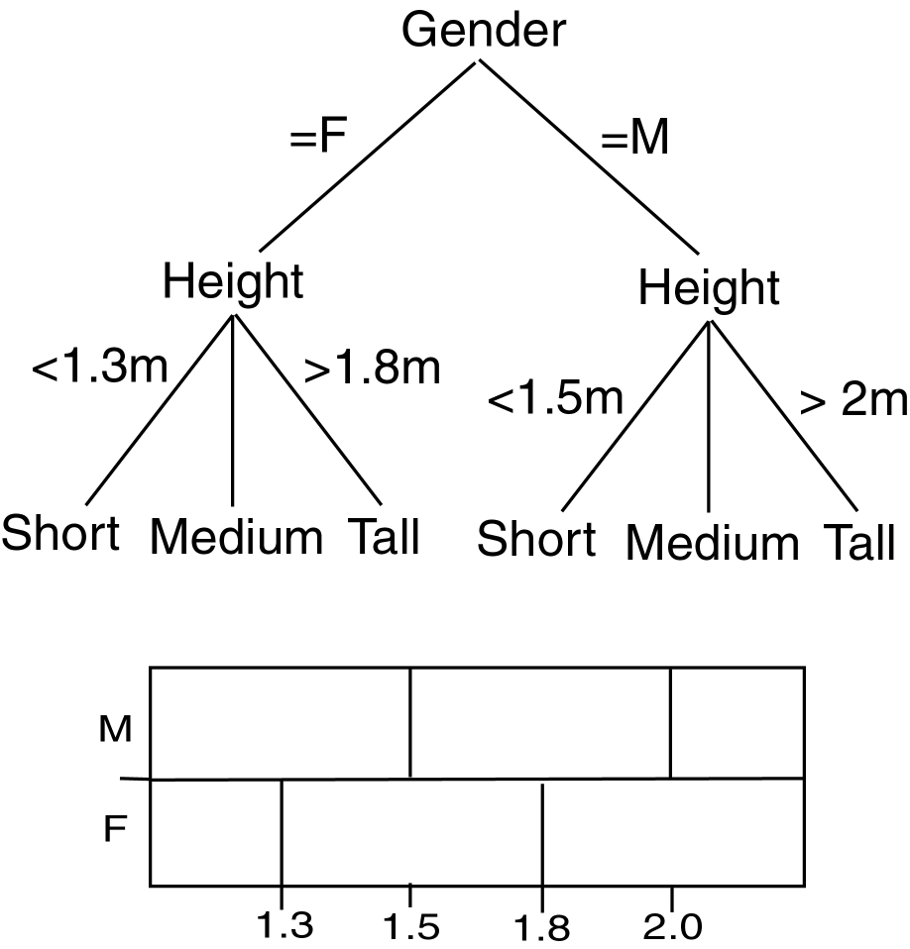
Comparing DTs
Balanced
Deep

Slide 85
DT Issues
Choosing Splitting Attributes
Ordering of Splitting Attributes
Splits
Tree Structure
Stopping Criteria
Training Data
Pruning

Slide 86
Decision Tree Induction is often based on Information Theory So

Slide 87
Information

Slide 88
DT Induction
When all the marbles in the bowl are mixed up, little information is given.
When the marbles in the bowl are all from one class and those in the other two classes are on either side, more information is given.
Use this approach with DT Induction !

Slide 89
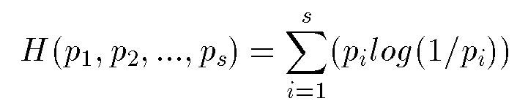
Information/Entropy
Given probabilitites p₁, p₂, .., p_{s} whose sum is 1, Entropy is defined as:
Entropy measures the amount of randomness or surprise or uncertainty.
Goal in classification
no surprise
entropy = 0

Slide 90
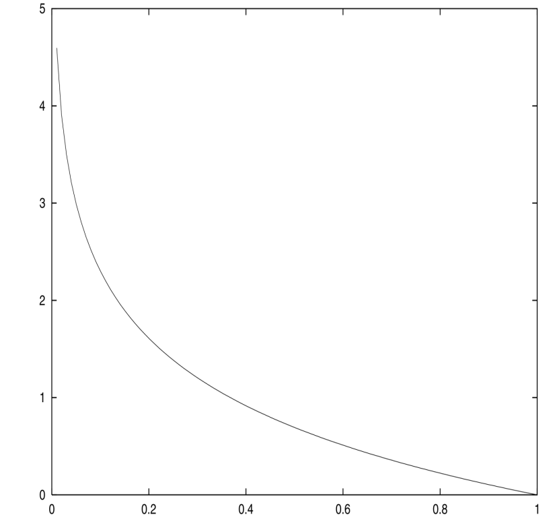
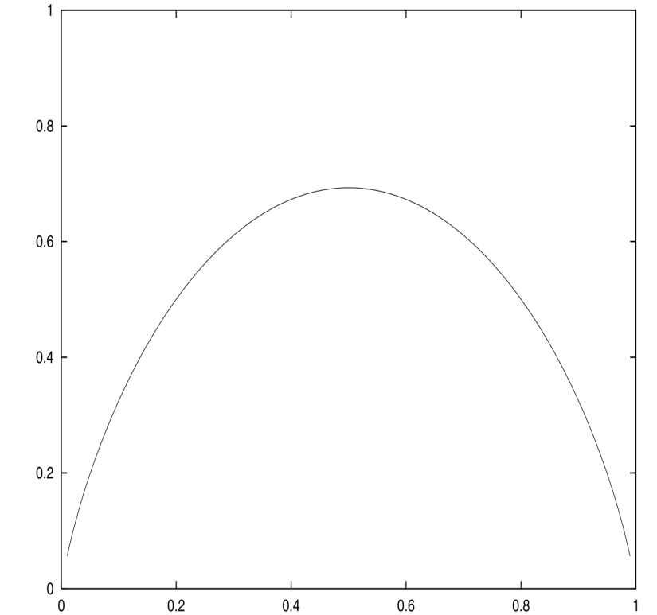
Entropy
log (1/p)
H(p,1-p)

Slide 91
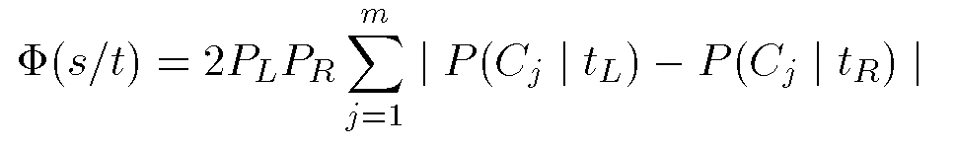
CART
Create Binary Tree
Uses entropy
Formula to choose split point, s, for node t:
P_{L},P_{R} probability that a tuple in the training set will be on the left or right side of the tree.

Slide 92
CART Example
At the start, there are six choices for split point (right branch on equality):
P(Gender)=2(6/15)(9/15)(2/15 + 4/15 + 3/15)=0.224
P(1.6) = 0
P(1.7) = 2(2/15)(13/15)(0 + 8/15 + 3/15) = 0.169
P(1.8) = 2(5/15)(10/15)(4/15 + 6/15 + 3/15) = 0.385
P(1.9) = 2(9/15)(6/15)(4/15 + 2/15 + 3/15) = 0.256
P(2.0) = 2(12/15)(3/15)(4/15 + 8/15 + 3/15) = 0.32
Split at 1.8

Slide 93
Classification Using Neural Networks
Typical NN structure for classification:
One output node per class
Output value is class membership function value
Supervised learning
For each tuple in training set, propagate it through NN. Adjust weights on edges to improve future classification.
Algorithms: Propagation, Backpropagation, Gradient Descent

Slide 94
NN Issues
Number of source nodes
Number of hidden layers
Training data
Number of sinks
Interconnections
Weights
Activation Functions
Learning Technique
When to stop learning

Slide 95
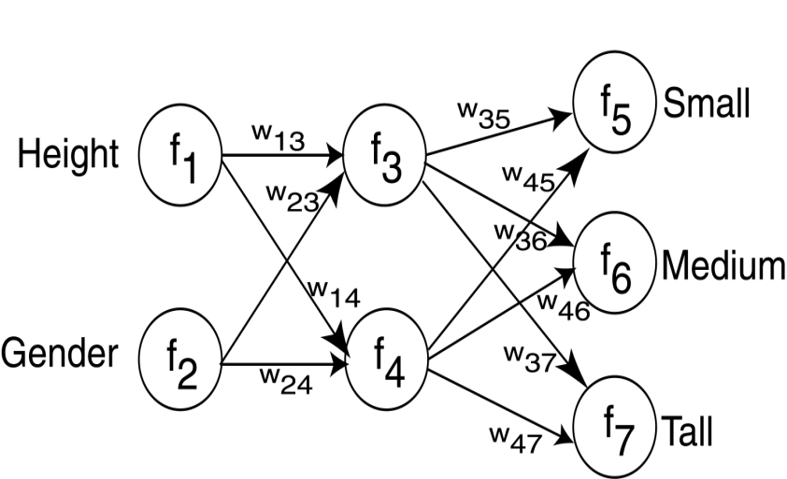
Decision Tree vs. Neural Network

Slide 96
NN Learning
Adjust weights to perform better with the associated test data.
Supervised: Use feedback from knowledge of correct classification.
Unsupervised: No knowledge of correct classification needed.

Slide 97
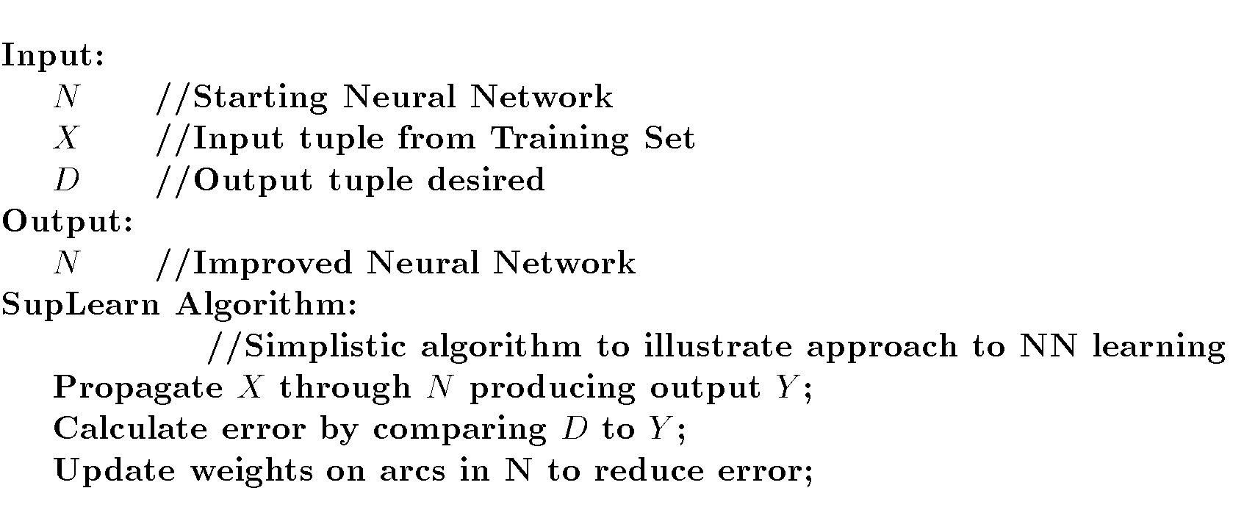
NN Supervised Learning

Slide 98
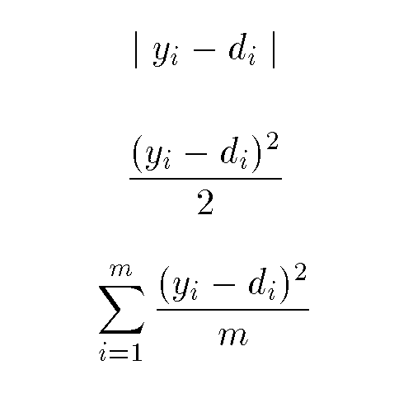
Supervised Learning
Possible error values assuming output from node i is y_{i} but should be d_{i}:
Change weights on arcs based on estimated error

Slide 99
Types of NNs
Different NN structures used for different problems.
Perceptron
Self Organizing Feature Map
Radial Basis Function Network

Slide 100
Self Organizing Feature Map (SOFM)
Competitive Unsupervised Learning
Observe how neurons work in brain:
Firing impacts firing of those near
Neurons far apart inhibit each other
Neurons have specific non-overlapping tasks
Ex: Kohonen Network

Slide 101
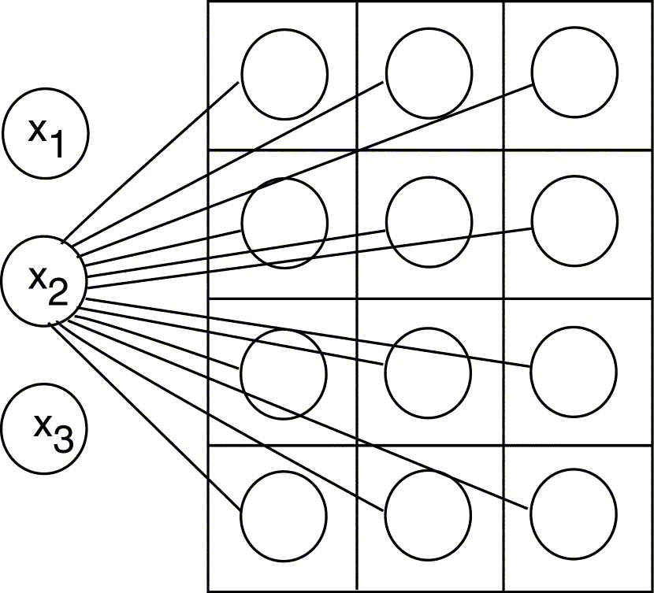
Kohonen Network

Slide 102
Kohonen Network
Competitive Layer – viewed as 2D grid
Similarity between competitive nodes and input nodes:
Input: X = <x₁, …, x_{h}>
Weights: <w_{1i}, … , w_{hi}>
Similarity defined based on dot product
Competitive node most similar to input “wins”
Winning node weights (as well as surrounding node weights) increased.

Slide 103
Classification Using Rules
Perform classification using If-Then rules
Classification Rule: r = <a,c>
Antecedent, Consequent
May generate from from other techniques (DT, NN) or generate directly.
Algorithms: Gen, RX, 1R, PRISM

Slide 104
Decision Tree vs. Rules
Tree has implied order in which splitting is performed.
Tree created based on looking at all classes.
Rules have no ordering of predicates.
Only need to look at one class to generate its rules.

Slide 105
Clustering Outline
Goal: Provide an overview of the clustering problem and introduce some of the basic algorithms
Clustering Problem Overview
Clustering Techniques
Hierarchical Algorithms
Partitional Algorithms
Genetic Algorithm
Clustering Large Databases

Slide 106
Clustering Examples
Segment customer database based on similar buying patterns.
Group houses in a town into neighborhoods based on similar features.
Identify new plant species
Identify similar Web usage patterns

Slide 107
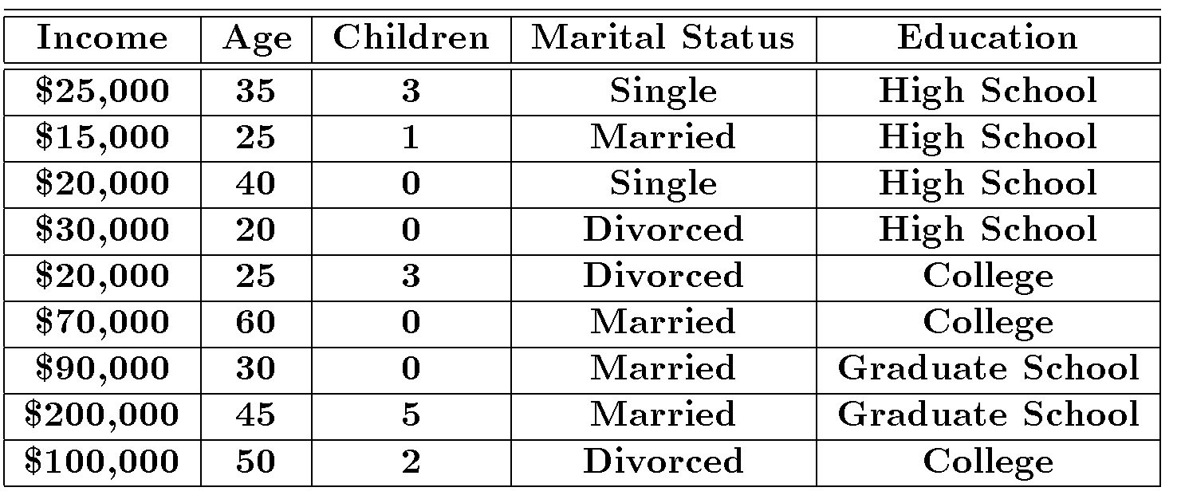
Clustering Example

Slide 108
Clustering Houses
Size Based
Geographic Distance Based

Slide 109
Clustering vs. Classification
No prior knowledge
Number of clusters
Meaning of clusters
Unsupervised learning

Slide 110
Clustering Issues
Outlier handling
Dynamic data
Interpreting results
Evaluating results
Number of clusters
Data to be used
Scalability

Slide 111
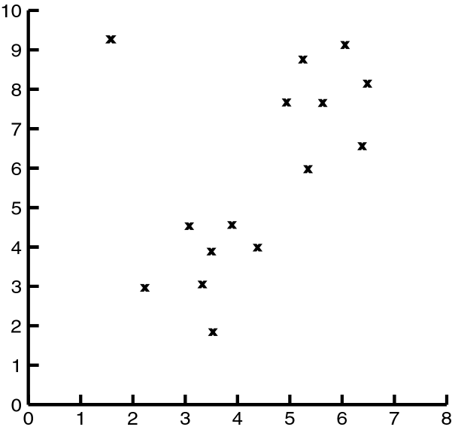
Impact of Outliers on Clustering

Slide 112
Clustering Problem
Given a database D={t₁,t₂,…,t_{n}} of tuples and an integer value k, the Clustering Problem is to define a mapping f:Dg{1,..,k} where each t_{i} is assigned to one cluster K_{j}, 1<=j<=k.
A Cluster, K_{j}, contains precisely those tuples mapped to it.
Unlike classification problem, clusters are not known a priori.

Slide 113
Types of Clustering
Hierarchical – Nested set of clusters created.
Partitional – One set of clusters created.
Incremental – Each element handled one at a time.
Simultaneous – All elements handled together.
Overlapping/Non-overlapping

Slide 114
Clustering Approaches
Clustering
Hierarchical
Partitional
Categorical
Large DB
Agglomerative
Divisive
Sampling
Compression

Slide 115
Distance Between Clusters
Single Link: smallest distance between points
Complete Link: largest distance between points
Average Link: average distance between points
Centroid: distance between centroids

Slide 116
Hierarchical Clustering
Clusters are created in levels actually creating sets of clusters at each level.
Agglomerative
Initially each item in its own cluster
Iteratively clusters are merged together
Bottom Up
Divisive
Initially all items in one cluster
Large clusters are successively divided
Top Down

Slide 117
Hierarchical Algorithms
Single Link
MST Single Link
Complete Link
Average Link

Slide 118
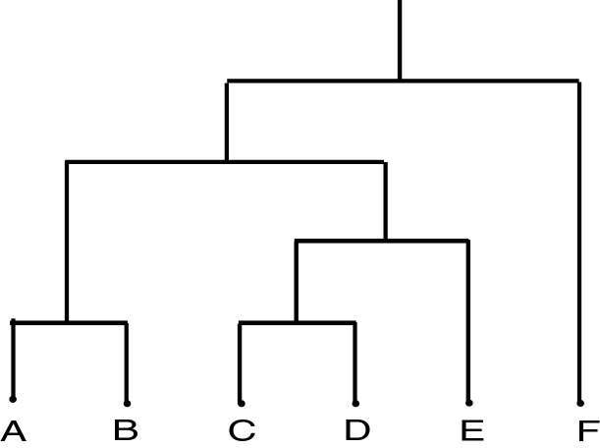
Dendrogram
Dendrogram: a tree data structure which illustrates hierarchical clustering techniques.
Each level shows clusters for that level.
Leaf – individual clusters
Root – one cluster
A cluster at level i is the union of its children clusters at level i+1.

Slide 119
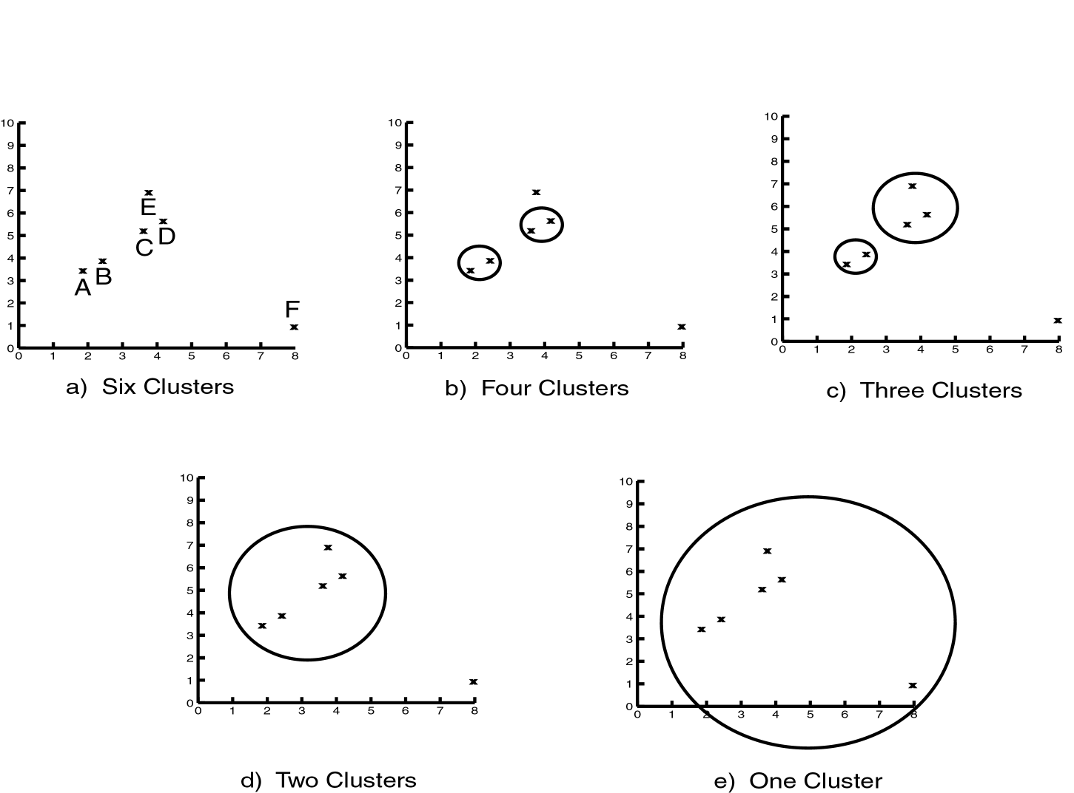
Levels of Clustering

Slide 120
Agglomerative Example
 | A | B | C | D | E
A | 0 | 1 | 2 | 2 | 3
B | 1 | 0 | 2 | 4 | 3
C | 2 | 2 | 0 | 1 | 5
D | 2 | 4 | 1 | 0 | 3
E | 3 | 3 | 5 | 3 | 0
A
B
E
C
D
Threshold of
1
2
3
4
5
A
B
C
D
E

Slide 121
MST Example
A
B
 | A | B | C | D | E
A | 0 | 1 | 2 | 2 | 3
B | 1 | 0 | 2 | 4 | 3
C | 2 | 2 | 0 | 1 | 5
D | 2 | 4 | 1 | 0 | 3
E | 3 | 3 | 5 | 3 | 0
E
C
D

Slide 122
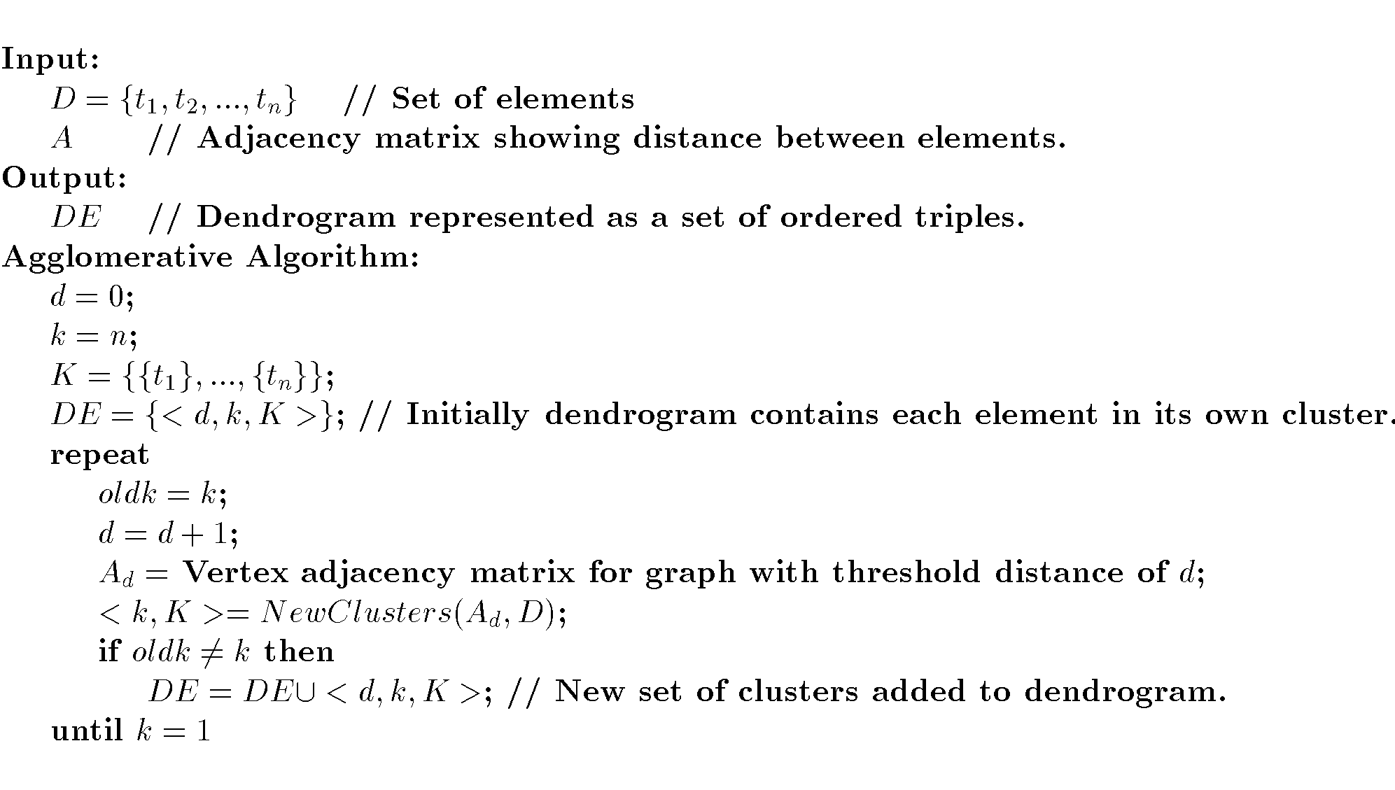
Agglomerative Algorithm

Slide 123
Single Link
View all items with links (distances) between them.
Finds maximal connected components in this graph.
Two clusters are merged if there is at least one edge which connects them.
Uses threshold distances at each level.
Could be agglomerative or divisive.

Slide 124
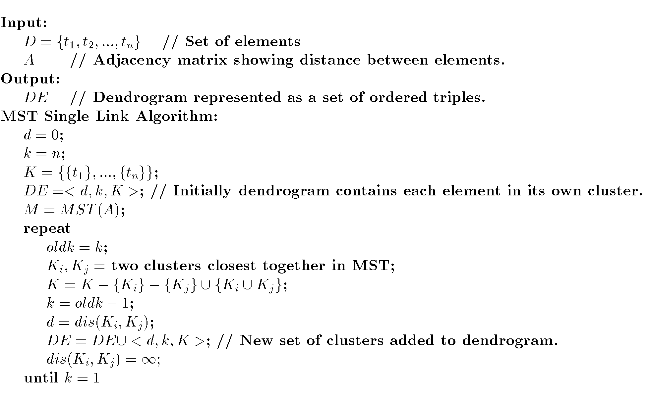
MST Single Link Algorithm

Slide 125
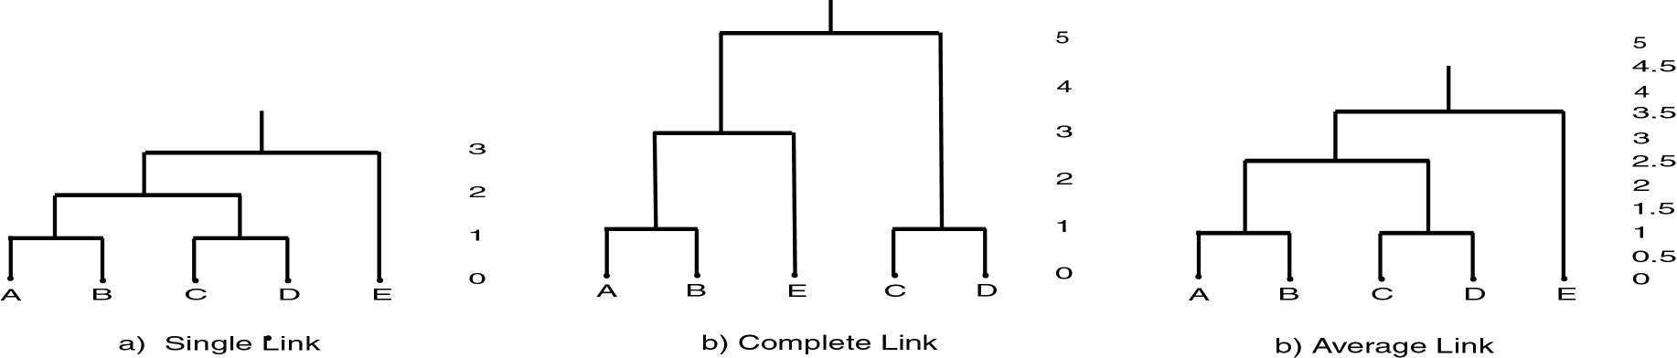
Single Link Clustering

Slide 126
Partitional Clustering
Nonhierarchical
Creates clusters in one step as opposed to several steps.
Since only one set of clusters is output, the user normally has to input the desired number of clusters, k.
Usually deals with static sets.

Slide 127
Partitional Algorithms
MST
Squared Error
K-Means
Nearest Neighbor
PAM
BEA
GA

Slide 128
Genetic Algorithm Example
{A,B,C,D,E,F,G,H}
Randomly choose initial solution:
{A,C,E} {B,F} {D,G,H} or
10101000, 01000100, 00010011
Suppose crossover at point four and choose 1st and 3rd individuals:
10100011, 01000100, 00011000
What should termination criteria be?

Slide 129
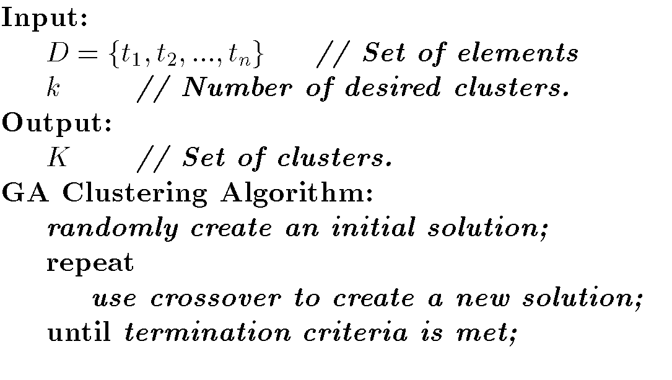
GA Algorithm

Slide 130
Clustering Large Databases
Most clustering algorithms assume a large data structure which is memory resident.
Clustering may be performed first on a sample of the database then applied to the entire database.
Algorithms
BIRCH
DBSCAN
CURE

Slide 131
Desired Features for Large Databases
One scan (or less) of DB
Online
Suspendable, stoppable, resumable
Incremental
Work with limited main memory
Different techniques to scan (e.g. sampling)
Process each tuple once

Slide 132
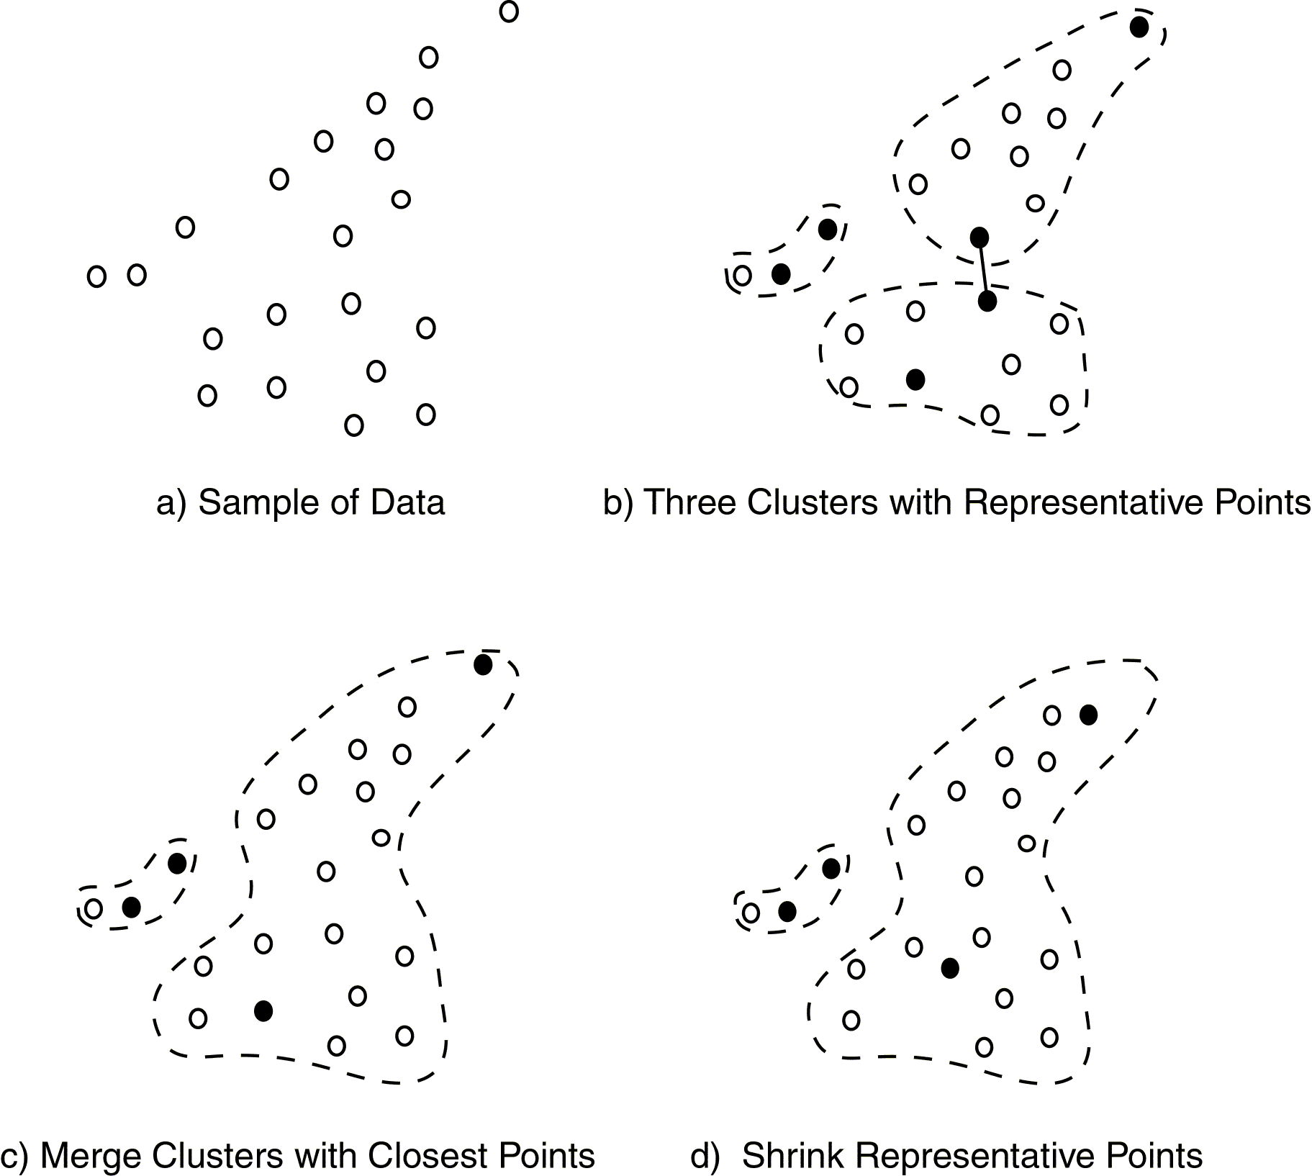
CURE Approach

Slide 133
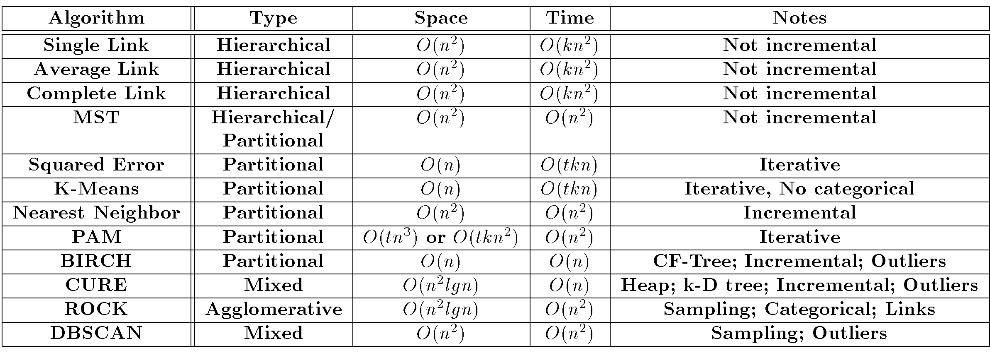
Comparison of Clustering Techniques

Slide 134
Association Rules Outline
Goal: Provide an overview of basic Association Rule mining techniques
Association Rules Problem Overview
Large itemsets
Association Rules Algorithms
Apriori
Sampling
Partitioning
Parallel Algorithms
Comparing Techniques
Incremental Algorithms
Advanced AR Techniques

Slide 135
Example: Market Basket Data
Items frequently purchased together:
Bread ⇒PeanutButter
Uses:
Placement
Advertising
Sales
Coupons
Objective: increase sales and reduce costs

Slide 136
Association Rule Definitions
Set of items: I={I₁,I₂,…,I_{m}}
Transactions: D={t₁,t₂, …, t_{n}}, t_{j}⊆ I
Itemset: {I_{i1},I_{i2}, …, I_{ik}} ⊆ I
Support of an itemset: Percentage of transactions which contain that itemset.
Large (Frequent) itemset: Itemset whose number of occurrences is above a threshold.

Slide 137
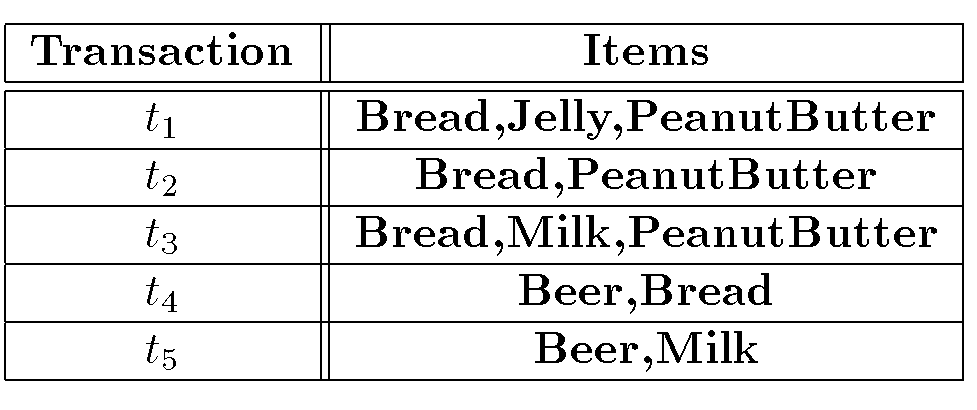
Association Rules Example
I = { Beer, Bread, Jelly, Milk, PeanutButter}
Support of {Bread,PeanutButter} is 60%

Slide 138
Association Rule Definitions
Association Rule (AR): implication X ⇒ Y where X,Y ⊆ I and X ∩ Y = ;
Support of AR (s) X ⇒ Y: Percentage of transactions that contain X ∪Y
Confidence of AR (α) X ⇒ Y: Ratio of number of transactions that contain X ∪ Y to the number that contain X

Slide 139
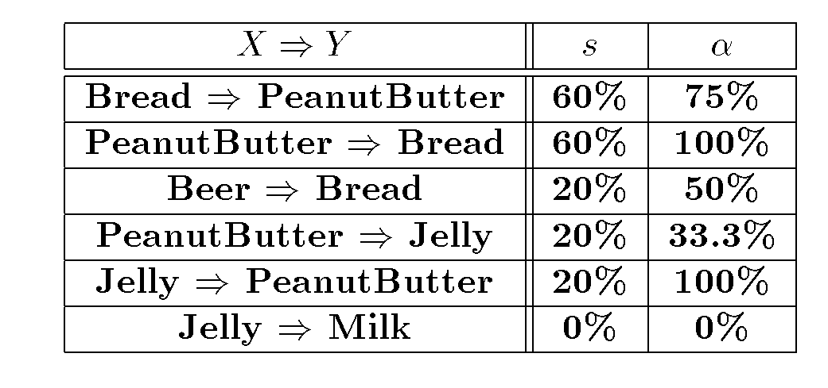
Association Rules Ex (cont’d)

Slide 140
Association Rule Problem
Given a set of items I={I₁,I₂,…,I_{m}} and a database of transactions D={t₁,t₂, …, t_{n}} where t_{i}={I_{i1},I_{i2}, …, I_{ik}} and I_{ij} ∈ I, the Association Rule Problem is to identify all association rules X ⇒ Y with a minimum support and confidence.
Link Analysis
NOTE: Support of X ⇒ Y is same as support of X ∪ Y.

Slide 141
Association Rule Techniques
Find Large Itemsets.
Generate rules from frequent itemsets.

Slide 142
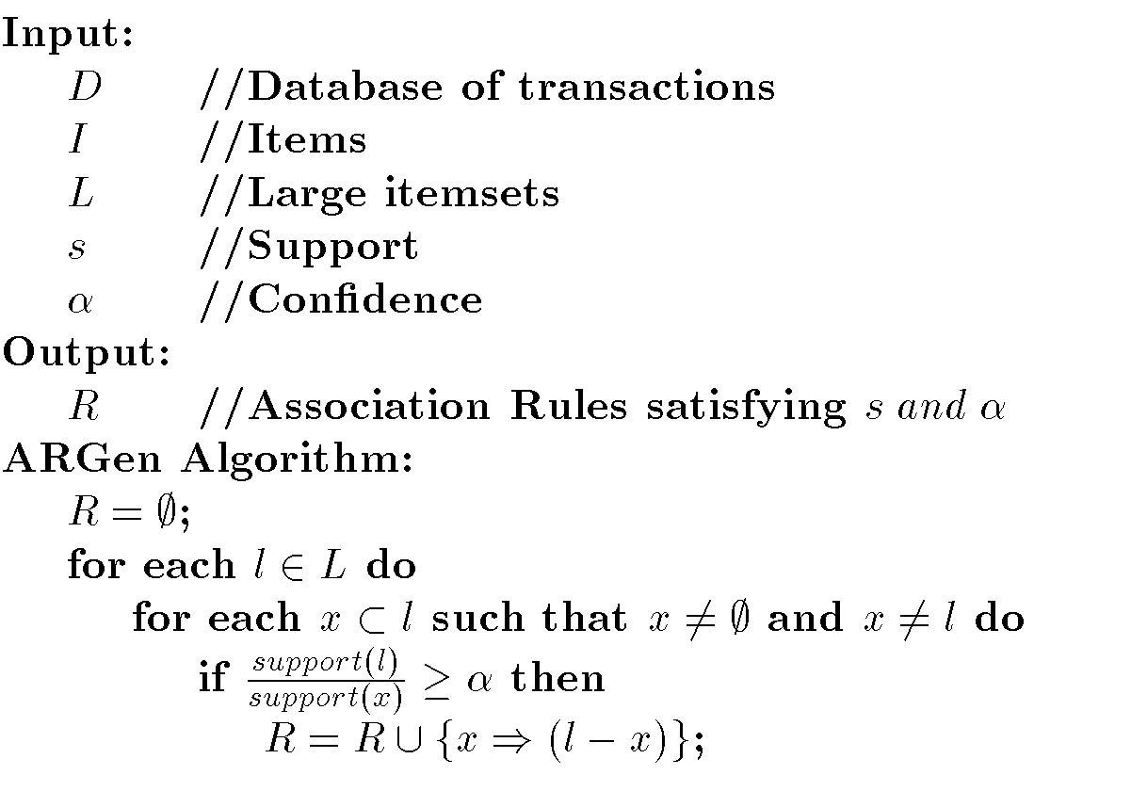
Algorithm to Generate ARs

Slide 143
Apriori
Large Itemset Property:
Any subset of a large itemset is large.
Contrapositive:
If an itemset is not large,
none of its supersets are large.

Slide 144

Large Itemset Property

Slide 145

Apriori Ex (cont’d)
s=30% α = 50%

Slide 146
Apriori Algorithm
C₁ = Itemsets of size one in I;
Determine all large itemsets of size 1, L_{1;}
i = 1;
Repeat
i = i + 1;
C_{i} = Apriori-Gen(L_{i-1});
Count C_{i} to determine L_{i;}
until no more large itemsets found;

Slide 147
Apriori-Gen
Generate candidates of size i+1 from large itemsets of size i.
Approach used: join large itemsets of size i if they agree on i-1
May also prune candidates who have subsets that are not large.

Slide 148

Apriori-Gen Example

Slide 149

Apriori-Gen Example (cont’d)

Slide 150
Apriori Adv/Disadv
Advantages:
Uses large itemset property.
Easily parallelized
Easy to implement.
Disadvantages:
Assumes transaction database is memory resident.
Requires up to m database scans.

Slide 151
Sampling
Large databases
Sample the database and apply Apriori to the sample.
Potentially Large Itemsets (PL): Large itemsets from sample
Negative Border (BD ⁻ ):
Generalization of Apriori-Gen applied to itemsets of varying sizes.
Minimal set of itemsets which are not in PL, but whose subsets are all in PL.

Slide 152

Negative Border Example
PL
PL ∪BD⁻(PL)

Slide 153
Sampling Algorithm
D_{s} = sample of Database D;
PL = Large itemsets in D_{s} using smalls;
C = PL ∪ BD⁻(PL);
Count C in Database using s;
ML = large itemsets in BD⁻(PL);
If ML = ∅ then done
else C = repeated application of BD^{-;}
Count C in Database;

Slide 154
Sampling Example
Find AR assuming s = 20%
D_{s} = { t₁,t₂}
Smalls = 10%
PL = {{Bread}, {Jelly}, {PeanutButter}, {Bread,Jelly}, {Bread,PeanutButter}, {Jelly, PeanutButter}, {Bread,Jelly,PeanutButter}}
BD⁻(PL)={{Beer},{Milk}}
ML = {{Beer}, {Milk}}
Repeated application of BD⁻ generates all remaining itemsets

Slide 155
Sampling Adv/Disadv
Advantages:
Reduces number of database scans to one in the best case and two in worst.
Scales better.
Disadvantages:
Potentially large number of candidates in second pass

Slide 156
Partitioning
Divide database into partitions D¹,D²,…,D^{p}
Apply Apriori to each partition
Any large itemset must be large in at least one partition.

Slide 157
Partitioning Algorithm
Divide D into partitions D¹,D²,…,D^{p;}
For I = 1 to p do
L^{i} = Apriori(D^{i});
C = L¹ ∪ … ∪ L^{p};
Count C on D to generate L;

Slide 158
Partitioning Example
L¹ ={{Bread}, {Jelly}, {PeanutButter}, {Bread,Jelly}, {Bread,PeanutButter}, {Jelly, PeanutButter}, {Bread,Jelly,PeanutButter}}
D¹
L² ={{Bread}, {Milk}, {PeanutButter}, {Bread,Milk}, {Bread,PeanutButter}, {Milk, PeanutButter}, {Bread,Milk,PeanutButter}, {Beer}, {Beer,Bread}, {Beer,Milk}}
D²
S=10%

Slide 159
Partitioning Adv/Disadv
Advantages:
Adapts to available main memory
Easily parallelized
Maximum number of database scans is two.
Disadvantages:
May have many candidates during second scan.

Slide 160
Parallelizing AR Algorithms
Based on Apriori
Techniques differ:
What is counted at each site
How data (transactions) are distributed
Data Parallelism
Data partitioned
Count Distribution Algorithm
Task Parallelism
Data and candidates partitioned
Data Distribution Algorithm

Slide 161
Count Distribution Algorithm(CDA)
Place data partition at each site.
In Parallel at each site do
C₁ = Itemsets of size one in I;
Count C_{1;}
Broadcast counts to all sites;
Determine global large itemsets of size 1, L₁;
i = 1;
Repeat
i = i + 1;
C_{i} = Apriori-Gen(L_{i-1});
Count C_{i;}
Broadcast counts to all sites;
Determine global large itemsets of size i, L_{i};
until no more large itemsets found;

Slide 162

CDA Example

Slide 163
Data Distribution Algorithm(DDA)
Place data partition at each site.
In Parallel at each site do
Determine local candidates of size 1 to count;
Broadcast local transactions to other sites;
Count local candidates of size 1 on all data;
Determine large itemsets of size 1 for local candidates;
Broadcast large itemsets to all sites;
Determine L₁;
i = 1;
Repeat
i = i + 1;
C_{i} = Apriori-Gen(L_{i-1});
Determine local candidates of size i to count;
Count, broadcast, and find L_{i};
until no more large itemsets found;

Slide 164

DDA Example

Slide 165
Comparing AR Techniques
Target
Type
Data Type
Data Source
Technique
Itemset Strategy and Data Structure
Transaction Strategy and Data Structure
Optimization
Architecture
Parallelism Strategy

Slide 166

Comparison of AR Techniques

Slide 167

Hash Tree

Slide 168
Incremental Association Rules
Generate ARs in a dynamic database.
Problem: algorithms assume static database
Objective:
Know large itemsets for D
Find large itemsets for D ∪ {Δ D}
Must be large in either D or Δ D
Save L_{i} and counts

Slide 169
Note on ARs
Many applications outside market basket data analysis
Prediction (telecom switch failure)
Web usage mining
Many different types of association rules
Temporal
Spatial
Causal

Slide 170
Advanced AR Techniques
Generalized Association Rules
Multiple-Level Association Rules
Quantitative Association Rules
Using multiple minimum supports
Correlation Rules

Slide 171
Measuring Quality of Rules
Support
Confidence
Interest
Conviction
Chi Squared Test

Slide 172
DATA MINING Introductory and Advanced Topics Part III

Slide 173
Data Mining Outline
PART I
Introduction
Related Concepts
Data Mining Techniques
PART II
Classification
Clustering
Association Rules
PART III
Web Mining
Spatial Mining
Temporal Mining

Slide 174
Web Mining Outline
Goal: Examine the use of data mining on the World Wide Web
Introduction
Web Content Mining
Web Structure Mining
Web Usage Mining

Slide 175
Web Mining Issues
Size
>350 million pages (1999)
Grows at about 1 million pages a day
Google indexes 3 billion documents
Diverse types of data

Slide 176
Web Data
Web pages
Intra-page structures
Inter-page structures
Usage data
Supplemental data
Profiles
Registration information
Cookies

Slide 177

Web Mining Taxonomy
Modified from [zai01]

Slide 178
Web Content Mining
Extends work of basic search engines
Search Engines
IR application
Keyword based
Similarity between query and document
Crawlers
Indexing
Profiles
Link analysis

Slide 179
Crawlers
Robot (spider) traverses the hypertext sructure in the Web.
Collect information from visited pages
Used to construct indexes for search engines
Traditional Crawler – visits entire Web (?) and replaces index
Periodic Crawler – visits portions of the Web and updates subset of index
Incremental Crawler – selectively searches the Web and incrementally modifies index
Focused Crawler – visits pages related to a particular subject

Slide 180
Focused Crawler
Only visit links from a page if that page is determined to be relevant.
Classifier is static after learning phase.
Components:
Classifier which assigns relevance score to each page based on crawl topic.
Distiller to identify hub pages.
Crawler visits pages to based on crawler and distiller scores.

Slide 181
Focused Crawler
Classifier to related documents to topics
Classifier also determines how useful outgoing links are
Hub Pages contain links to many relevant pages. Must be visited even if not high relevance score.

Slide 182

Focused Crawler

Slide 183
Context Focused Crawler
Context Graph:
Context graph created for each seed document .
Root is the sedd document.
Nodes at each level show documents with links to documents at next higher level.
Updated during crawl itself .
Approach:
Construct context graph and classifiers using seed documents as training data.
Perform crawling using classifiers and context graph created.

Slide 184

Context Graph

Slide 185
Virtual Web View
Multiple Layered DataBase (MLDB) built on top of the Web.
Each layer of the database is more generalized (and smaller) and centralized than the one beneath it.
Upper layers of MLDB are structured and can be accessed with SQL type queries.
Translation tools convert Web documents to XML.
Extraction tools extract desired information to place in first layer of MLDB.
Higher levels contain more summarized data obtained through generalizations of the lower levels.

Slide 186
Personalization
Web access or contents tuned to better fit the desires of each user.
Manual techniques identify user’s preferences based on profiles or demographics.
Collaborative filtering identifies preferences based on ratings from similar users.
Content based filtering retrieves pages based on similarity between pages and user profiles.

Slide 187
Web Structure Mining
Mine structure (links, graph) of the Web
Techniques
PageRank
CLEVER
Create a model of the Web organization.
May be combined with content mining to more effectively retrieve important pages.

Slide 188
PageRank
Used by Google
Prioritize pages returned from search by looking at Web structure.
Importance of page is calculated based on number of pages which point to it – Backlinks.
Weighting is used to provide more importance to backlinks coming form important pages.

Slide 189
PageRank (cont’d)
PR(p) = c (PR(1)/N₁ + … + PR(n)/N_{n})
PR(i): PageRank for a page i which points to target page p.
N_{i}: number of links coming out of page i

Slide 190
CLEVER
Identify authoritative and hub pages.
Authoritative Pages :
Highly important pages.
Best source for requested information.
Hub Pages :
Contain links to highly important pages.

Slide 191
HITS
Hyperlink-Induces Topic Search
Based on a set of keywords, find set of relevant pages – R.
Identify hub and authority pages for these.
Expand R to a base set, B, of pages linked to or from R.
Calculate weights for authorities and hubs.
Pages with highest ranks in R are returned.

Slide 192

HITS Algorithm

Slide 193
Web Usage Mining
Extends work of basic search engines
Search Engines
IR application
Keyword based
Similarity between query and document
Crawlers
Indexing
Profiles
Link analysis

Slide 194
Web Usage Mining Applications
Personalization
Improve structure of a site’s Web pages
Aid in caching and prediction of future page references
Improve design of individual pages
Improve effectiveness of e-commerce (sales and advertising)

Slide 195
Web Usage Mining Activities
Preprocessing Web log
Cleanse
Remove extraneous information
Sessionize
Session: Sequence of pages referenced by one user at a sitting.
Pattern Discovery
Count patterns that occur in sessions
Pattern is sequence of pages references in session.
Similar to association rules
Transaction: session
Itemset: pattern (or subset)
Order is important
Pattern Analysis

Slide 196
ARs in Web Mining
Web Mining:
Content
Structure
Usage
Frequent patterns of sequential page references in Web searching.
Uses:
Caching
Clustering users
Develop user profiles
Identify important pages

Slide 197
Web Usage Mining Issues
Identification of exact user not possible.
Exact sequence of pages referenced by a user not possible due to caching.
Session not well defined
Security, privacy, and legal issues

Slide 198
Web Log Cleansing
Replace source IP address with unique but non-identifying ID.
Replace exact URL of pages referenced with unique but non-identifying ID.
Delete error records and records containing not page data (such as figures and code)

Slide 199
Sessionizing
Divide Web log into sessions.
Two common techniques:
Number of consecutive page references from a source IP address occurring within a predefined time interval (e.g. 25 minutes).
All consecutive page references from a source IP address where the interclick time is less than a predefined threshold.

Slide 200
Data Structures
Keep track of patterns identified during Web usage mining process
Common techniques:
Trie
Suffix Tree
Generalized Suffix Tree
WAP Tree

Slide 201
Trie vs. Suffix Tree
Trie:
Rooted tree
Edges labeled which character (page) from pattern
Path from root to leaf represents pattern.
Suffix Tree:
Single child collapsed with parent. Edge contains labels of both prior edges.

Slide 202

Trie and Suffix Tree

Slide 203
Generalized Suffix Tree
Suffix tree for multiple sessions.
Contains patterns from all sessions.
Maintains count of frequency of occurrence of a pattern in the node.
WAP Tree:
Compressed version of generalized suffix tree

Slide 204
Types of Patterns
Algorithms have been developed to discover different types of patterns.
Properties:
Ordered – Characters (pages) must occur in the exact order in the original session.
Duplicates – Duplicate characters are allowed in the pattern.
Consecutive – All characters in pattern must occur consecutive in given session.
Maximal – Not subsequence of another pattern.

Slide 205
Pattern Types
Association Rules
None of the properties hold
Episodes
Only ordering holds
Sequential Patterns
Ordered and maximal
Forward Sequences
Ordered, consecutive, and maximal
Maximal Frequent Sequences
All properties hold

Slide 206
Episodes
Partially ordered set of pages
Serial episode – totally ordered with time constraint
Parallel episode – partial ordered with time constraint
General episode – partial ordered with no time constraint

Slide 207

DAG for Episode

Slide 208
Spatial Mining Outline
Goal: Provide an introduction to some spatial mining techniques.
Introduction
Spatial Data Overview
Spatial Data Mining Primitives
Generalization/Specialization
Spatial Rules
Spatial Classification
Spatial Clustering

Slide 209
Spatial Object
Contains both spatial and nonspatial attributes.
Must have a location type attributes:
Latitude/longitude
Zip code
Street address
May retrieve object using either (or both) spatial or nonspatial attributes.

Slide 210
Spatial Data Mining Applications
Geology
GIS Systems
Environmental Science
Agriculture
Medicine
Robotics
May involved both spatial and temporal aspects

Slide 211
Spatial Queries
Spatial selection may involve specialized selection comparison operations:
Near
North, South, East, West
Contained in
Overlap/intersect
Region (Range) Query – find objects that intersect a given region.
Nearest Neighbor Query – find object close to identified object.
Distance Scan – find object within a certain distance of an identified object where distance is made increasingly larger.

Slide 212
Spatial Data Structures
Data structures designed specifically to store or index spatial data.
Often based on B-tree or Binary Search Tree
Cluster data on disk basked on geographic location.
May represent complex spatial structure by placing the spatial object in a containing structure of a specific geographic shape.
Techniques:
Quad Tree
R-Tree
k-D Tree

Slide 213

MBR
Minimum Bounding Rectangle
Smallest rectangle that completely contains the object

Slide 214

MBR Examples

Slide 215
Quad Tree
Hierarchical decomposition of the space into quadrants (MBRs)
Each level in the tree represents the object as the set of quadrants which contain any portion of the object.
Each level is a more exact representation of the object.
The number of levels is determined by the degree of accuracy desired.

Slide 216

Quad Tree Example

Slide 217
R-Tree
As with Quad Tree the region is divided into successively smaller rectangles (MBRs).
Rectangles need not be of the same size or number at each level.
Rectangles may actually overlap.
Lowest level cell has only one object.
Tree maintenance algorithms similar to those for B-trees.

Slide 218

R-Tree Example

Slide 219
K-D Tree
Designed for multi-attribute data, not necessarily spatial
Variation of binary search tree
Each level is used to index one of the dimensions of the spatial object.
Lowest level cell has only one object
Divisions not based on MBRs but successive divisions of the dimension range.

Slide 220

k-D Tree Example

Slide 221
Topological Relationships
Disjoint
Overlaps or Intersects
Equals
Covered by or inside or contained in
Covers or contains

Slide 222

Distance Between Objects
Euclidean
Manhattan
Extensions:

Slide 223
Progressive Refinement
Make approximate answers prior to more accurate ones.
Filter out data not part of answer
Hierarchical view of data based on spatial relationships
Coarse predicate recursively refined

Slide 224

Progressive Refinement

Slide 225

Spatial Data Dominant Algorithm

Slide 226
STING
STatistical Information Grid-based
Hierarchical technique to divide area into rectangular cells
Grid data structure contains summary information about each cell
Hierarchical clustering
Similar to quad tree

Slide 227

STING

Slide 228

STING Build Algorithm

Slide 229

STING Algorithm

Slide 230
Spatial Rules
Characteristic Rule
The average family income in Dallas is $50,000.
Discriminant Rule
The average family income in Dallas is $50,000, while in Plano the average income is $75,000.
Association Rule
The average family income in Dallas for families living near White Rock Lake is $100,000.

Slide 231
Spatial Association Rules
Either antecedent or consequent must contain spatial predicates.
View underlying database as set of spatial objects.
May create using a type of progressive refinement

Slide 232

Spatial Association Rule Algorithm

Slide 233
Spatial Classification
Partition spatial objects
May use nonspatial attributes and/or spatial attributes
Generalization and progressive refinement may be used.

Slide 234
ID3 Extension
Neighborhood Graph
Nodes – objects
Edges – connects neighbors
Definition of neighborhood varies
ID3 considers nonspatial attributes of all objects in a neighborhood (not just one) for classification.

Slide 235
Spatial Decision Tree
Approach similar to that used for spatial association rules.
Spatial objects can be described based on objects close to them – Buffer.
Description of class based on aggregation of nearby objects.

Slide 236

Spatial Decision Tree Algorithm

Slide 237
Spatial Clustering
Detect clusters of irregular shapes
Use of centroids and simple distance approaches may not work well.
Clusters should be independent of order of input.

Slide 238

Spatial Clustering

Slide 239
CLARANS Extensions
Remove main memory assumption of CLARANS.
Use spatial index techniques.
Use sampling and R*-tree to identify central objects.
Change cost calculations by reducing the number of objects examined.
Voronoi Diagram

Slide 240

Voronoi

Slide 241
SD(CLARANS)
Spatial Dominant
First clusters spatial components using CLARANS
Then iteratively replaces medoids, but limits number of pairs to be searched.
Uses generalization
Uses a learning to to derive description of cluster.

Slide 242

SD(CLARANS) Algorithm

Slide 243
DBCLASD
Extension of DBSCAN
Distribution Based Clustering of LArge Spatial Databases
Assumes items in cluster are uniformly distributed.
Identifies distribution satisfied by distances between nearest neighbors.
Objects added if distribution is uniform.

Slide 244

DBCLASD Algorithm

Slide 245
Aggregate Proximity
Aggregate Proximity – measure of how close a cluster is to a feature.
Aggregate proximity relationship finds the k closest features to a cluster.
CRH Algorithm – uses different shapes:
Encompassing Circle
Isothetic Rectangle
Convex Hull

Slide 246

CRH

Slide 247
Temporal Mining Outline
Goal: Examine some temporal data mining issues and approaches.
Introduction
Modeling Temporal Events
Time Series
Pattern Detection
Sequences
Temporal Association Rules

Slide 248

Temporal Database
Snapshot – Traditional database
Temporal – Multiple time points
Ex:

Slide 249
Temporal Queries
Query
Database
Intersection Query
Inclusion Query
Containment Query
Point Query – Tuple retrieved is valid at a particular point in time.
t_{s}^{q} t_{e}^{q}
t_{s}^{d} t_{e}^{d}
t_{s}^{q} t_{e}^{q}
t_{s}^{d} t_{e}^{d}
t_{s}^{q} t_{e}^{q}
t_{s}^{d} t_{e}^{d}
t_{s}^{d} t_{e}^{d}
t_{s}^{q} t_{e}^{q}

Slide 250
Types of Databases
Snapshot – No temporal support
Transaction Time – Supports time when transaction inserted data
Timestamp
Range
Valid Time – Supports time range when data values are valid
Bitemporal – Supports both transaction and valid time.

Slide 251
Modeling Temporal Events
Techniques to model temporal events.
Often based on earlier approaches
Finite State Recognizer (Machine) (FSR)
Each event recognizes one character
Temporal ordering indicated by arcs
May recognize a sequence
Require precisely defined transitions between states
Approaches
Markov Model
Hidden Markov Model
Recurrent Neural Network

Slide 252

FSR

Slide 253
Markov Model (MM)
Directed graph
Vertices represent states
Arcs show transitions between states
Arc has probability of transition
At any time one state is designated as current state.
Markov Property – Given a current state, the transition probability is independent of any previous states.
Applications: speech recognition, natural language processing

Slide 254

Markov Model

Slide 255
Hidden Markov Model (HMM)
Like HMM, but states need not correspond to observable states.
HMM models process that produces as output a sequence of observable symbols.
HMM will actually output these symbols.
Associated with each node is the probability of the observation of an event.
Train HMM to recognize a sequence.
Transition and observation probabilities learned from training set.

Slide 256

Hidden Markov Model
Modified from [RJ86]

Slide 257

HMM Algorithm

Slide 258
HMM Applications
Given a sequence of events and an HMM, what is the probability that the HMM produced the sequence?
Given a sequence and an HMM, what is the most likely state sequence which produced this sequence?

Slide 259
Recurrent Neural Network (RNN)
Extension to basic NN
Neuron can obtian input form any other neuron (including output layer).
Can be used for both recognition and prediction applications.
Time to produce output unknown
Temporal aspect added by backlinks.

Slide 260

RNN

Slide 261
Time Series
Set of attribute values over time
Time Series Analysis – finding patterns in the values.
Trends
Cycles
Seasonal
Outliers

Slide 262
Analysis Techniques
Smoothing – Moving average of attribute values.
Autocorrelation – relationships between different subseries
Yearly, seasonal
Lag – Time difference between related items.
Correlation Coefficient r

Slide 263

Smoothing

Slide 264

Correlation with Lag of 3

Slide 265
Similarity
Determine similarity between a target pattern, X, and sequence, Y: sim(X,Y)
Similar to Web usage mining
Similar to earlier word processing and spelling corrector applications.
Issues:
Length
Scale
Gaps
Outliers
Baseline

Slide 266
Longest Common Subseries
Find longest subseries they have in common.
Ex:
X = <10,5,6,9,22,15,4,2>
Y = <6,9,10,5,6,22,15,4,2>
Output: <22,15,4,2>
Sim(X,Y) = l/n = 4/9

Slide 267

Similarity based on Linear Transformation
Linear transformation function f
Convert a value form one series to a value in the second
ε_{f} – tolerated difference in results
δ – time value difference allowed

Slide 268
Prediction
Predict future value for time series
Regression may not be sufficient
Statistical Techniques
ARMA
ARIMA
NN

Slide 269
Pattern Detection
Identify patterns of behavior in time series
Speech recognition, signal processing
FSR, MM, HMM

Slide 270

String Matching
Find given pattern in sequence
Knuth-Morris-Pratt: Construct FSM
Boyer-Moore: Construct FSM

Slide 271
Distance between Strings
Cost to convert one to the other
Transformations
Match: Current characters in both strings are the same
Delete: Delete current character in input string
Insert: Insert current character in target string into string

Slide 272

Distance between Strings

Slide 273

Frequent Sequence

Slide 274

Frequent Sequence Example
Purchases made by customers
s(<{A},{C}>) = 1/3
s(<{A},{D}>) = 2/3
s(<{B,C},{D}>) = 2/3

Slide 275

Frequent Sequence Lattice

Slide 276
SPADE
Sequential Pattern Discovery using Equivalence classes
Identifies patterns by traversing lattice in a top down manner.
Divides lattice into equivalent classes and searches each separately.
ID-List: Associates customers and transactions with each item.

Slide 277

SPADE Example
ID-List for Sequences of length 1:
Count for <{A}> is 3
Count for <{A},{D}> is 2

Slide 278

Θ₁ Equivalence Classes

Slide 279

SPADE Algorithm

Slide 280
Temporal Association Rules
Transaction has time:
<TID,CID,I₁,I₂, …, I_{m},t_{s},t_{e}>
[t_{s},t_{e}] is range of time the transaction is active.
Types:
Inter-transaction rules
Episode rules
Trend dependencies
Sequence association rules
Calendric association rules

Slide 281
Inter-transaction Rules
Intra-transaction association rules
Traditional association Rules
Inter-transaction association rules
Rules across transactions
Sliding window – How far apart (time or number of transactions) to look for related itemsets.

Slide 282
Episode Rules
Association rules applied to sequences of events.
Episode – set of event predicates and partial ordering on them

Slide 283

Trend Dependencies
Association rules across two database states based on time.
Ex: (SSN,=) ⇒ (Salary, ≤)
Confidence=4/5
Support=4/36

Slide 284
Sequence Association Rules
Association rules involving sequences
Ex:
<{A},{C}> ⇒ <{A},{D}>
Support = 1/3
Confidence 1

Slide 285
Calendric Association Rules
Each transaction has a unique timestamp.
Group transactions based on time interval within which they occur.
Identify large itemsets by looking at transactions only in this predefined interval.

